Slide 1
Casual Friday Series
Interrupting Neuropathy Pt II
A Biogenetix Clinical Presentation
BIOGENETIX.COM

Slide 2
Disclaimer
Information in this presentation is not intended to diagnose, treat, reverse, cure, or prevent any disease. While this presentation is based on medical literature, findings, and text, The following statements have not been evaluated by the FDA.
The information provided in this presentation is for your consideration only as a practicing health care provider. Ultimately you are responsible for exercising professional judgment in the care of your own patients.

Slide 3
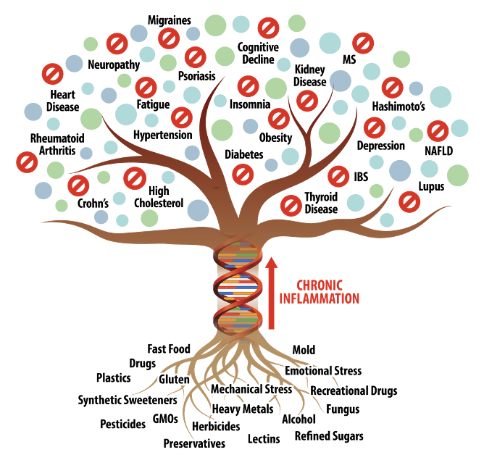

Slide 4
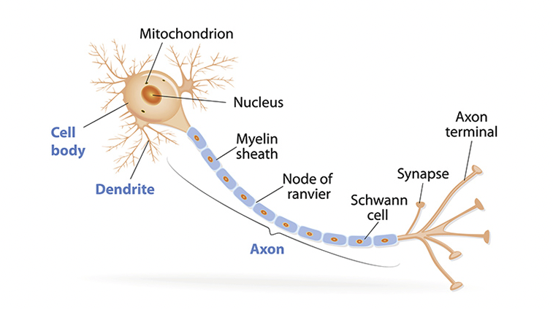
https://qbi.uq.edu.au/brain/brain-anatomy/axons-cable-transmission-neurons

Slide 5
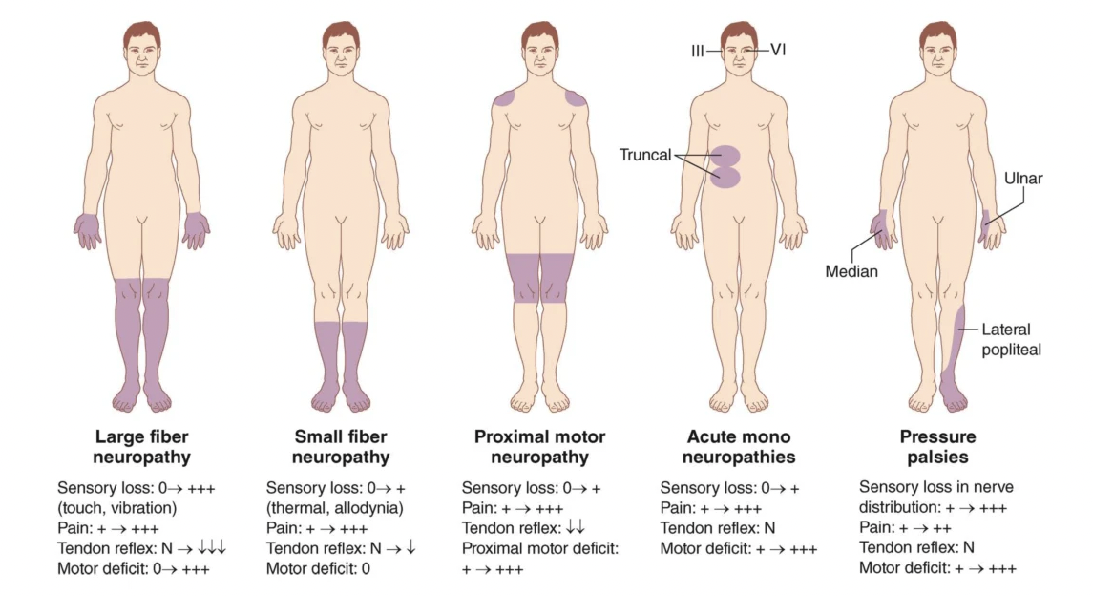
CLINICAL FEATURES
https://diabetes.medicinematters.com/neuropathy/schematic-representation-of-different-clinical-presentations-of/15490212

Slide 6
Signs
Signs of peripheral neuropathy also include sensory, motor and autonomic components.
The most prominent autonomic sign of neuropathy is orthostatic hypotension
https://www.urmc.rochester.edu/MediaLibraries/URMCMedia/center-experiential-learning/cme/types-of-activities/documents/PERIPHERAL-NEUROPATHY-HANDOUT.pdf

Slide 7
CLASSIFICATION
There are many ways to classify peripheral neuropathy. One helpful method is to consider four categories, namely etiology, distribution, pathology and modality.
https://www.urmc.rochester.edu/MediaLibraries/URMCMedia/center-experiential-learning/cme/types-of-activities/documents/PERIPHERAL-NEUROPATHY-HANDOUT.pdf

Slide 8
The mnemonic DANG THERAPIST is helpful in recalling the more common causes of peripheral neuropathy:
Diabetes Mellitus Alcohol Nutritional (B12 deficiency) Guillain-Barre Syndrome Toxins (Pb, As, Zn, Hg) Hematologic (cancers, etc.) Endocrine (hypothyroid) Rheumatologic (SLE, rheumatoid arthritis, vasculitis)
Amyloid
Porphyria Infectious (syphilis, HIV) Sarcoid Tumor (paraneoplastic neuropathy)
https://www.urmc.rochester.edu/MediaLibraries/URMCMedia/center-experiential-learning/cme/types-of-activities/documents/PERIPHERAL-NEUROPATHY-HANDOUT.pdf

Slide 9
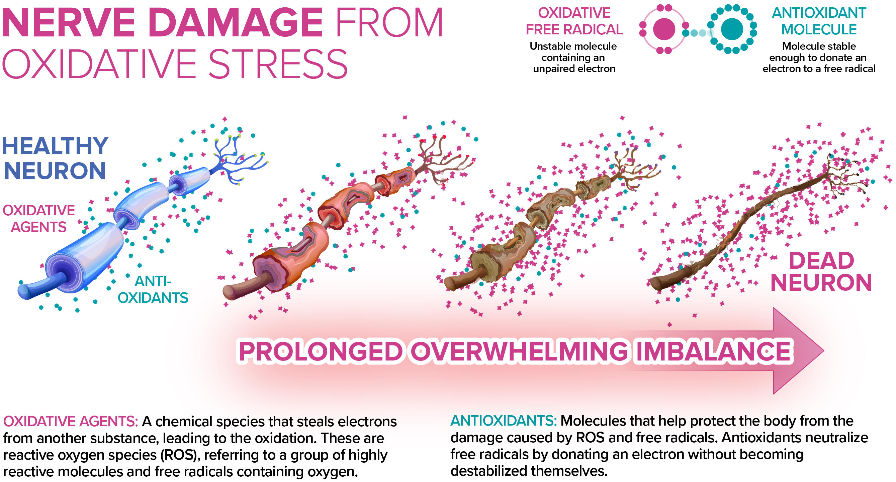

Slide 10
LABORATORY INVESTIGATION
Laboratory studies play an important role in diagnosing and categorizing the peripheral neuropathies. Electrodiagnostic studies are helpful in quantitating the neuropathy, while blood and urine studies are helpful in identifying an etiology.
Electrodiagnostic Studies:
Nerve Conduction Study
Electromyography (EMG)
https://www.urmc.rochester.edu/MediaLibraries/URMCMedia/center-experiential-learning/cme/types-of-activities/documents/PERIPHERAL-NEUROPATHY-HANDOUT.pdf

Slide 11
Nerve Conduction Study:
The recording and measurement of the compound nerve and muscle action potential elicited in response to a single supramaximal electrical stimulus, to measure the terminal latency, amplitude and duration of the evoked potential, as well as the conduction velocity.
Nerve conduction studies are helpful in documenting that a neuropathy exists, quantitating the severity, and noting the distribution of the neuropathy, i.e. whether it is distal, proximal or diffuse. In addition, nerve conduction studies can provide information on the modality involved, i.e. motor versus sensory, and can also give clues as to the underlying pathology, whether axonal or demyelinating.
https://www.urmc.rochester.edu/MediaLibraries/URMCMedia/center-experiential-learning/cme/types-of-activities/documents/PERIPHERAL-NEUROPATHY-HANDOUT.pdf

Slide 12
Demyelinating neuropathies (neuropathies due to loss or destruction of myelin) result in slowed conduction velocities and prolonged distal latencies, because conduction velocity is proportional to the velocity of the largest-diameter myelinated fibers. Dispersion of evoked compound action potentials (CAP) can also be seen in demyelinating neuropathies, because all of the action potentials elicited in response to a single electrical stimulus will not reach the recording potential at the same time. Severe demyelinating neuropathies can also produce conduction block, which is a major decrease in amplitude of the muscle CAP upon proximal stimulation of its nerve as compared to distal stimulation.
Axonal neuropathies (neuropathies due to loss of axons or their cell bodies) generally result in a reduced amplitude of the compound motor or sensory nerve action potentials.
https://www.urmc.rochester.edu/MediaLibraries/URMCMedia/center-experiential-learning/cme/types-of-activities/documents/PERIPHERAL-NEUROPATHY-HANDOUT.pdf

Slide 13
Electromyography (EMG):
The recording and study of insertional, spontaneous, and voluntary electrical activity of muscle.
This test allows one to physiologically evaluate the motor unit, including the anterior horn cell, peripheral nerve, and muscle. EMG is helpful when evaluating patients with weakness, in that it can help one determine whether weakness is due to anterior horn cell disease, nerve root compression, peripheral neuropathy, or an intrinsic disease of muscle itself (myopathy).
EMG can differentiate acute denervation from chronic denervation, and may thus give an indication as to the time course of the lesion causing the neuropathy.
https://www.urmc.rochester.edu/MediaLibraries/URMCMedia/center-experiential-learning/cme/types-of-activities/documents/PERIPHERAL-NEUROPATHY-HANDOUT.pdf

Slide 14
Acute Denervation: Fibrillations and positive waves are present indicating spontaneous discharge of individual muscle fibers.
Chronic Denervation: Voluntary motor unit potentials are of large amplitude and long duration, and are frequently polyphasic, because the motor units are enlarged as a result of re-innervation of adjacent previously denervated muscle fibers. Recruitment of additional motor units in response to increasing the force of muscular contraction is reduced for the same reason.
Demyelinating Neuropathy: A decreased recruitment pattern is seen, since demyelination interferes with conduction of individual action potentials along the course of a peripheral nerve. Because denervation and reinnervation of muscle fibers are not features of demyelinating neuropathies, the configuration of the voluntary motor unit potentials is usually normal, and fibrillation potentials are not seen.
https://www.urmc.rochester.edu/MediaLibraries/URMCMedia/center-experiential-learning/cme/types-of-activities/documents/PERIPHERAL-NEUROPATHY-HANDOUT.pdf

Slide 15
Blood Studies
Routine blood studies should be obtained in all patients with peripheral neuropathy in order to screen for reversible causes. The following blood tests are recommended:
Complete blood count
Chemistry profile
Sedimentation rate
Thyroid studies
Vitamin B12 level
ANA, rheumatoid factor
Serum protein electrophoresis, serum immuno-electrophoresis
RPR and HIV (if the clinical situation warrants)
https://www.urmc.rochester.edu/MediaLibraries/URMCMedia/center-experiential-learning/cme/types-of-activities/documents/PERIPHERAL-NEUROPATHY-HANDOUT.pdf

Slide 16
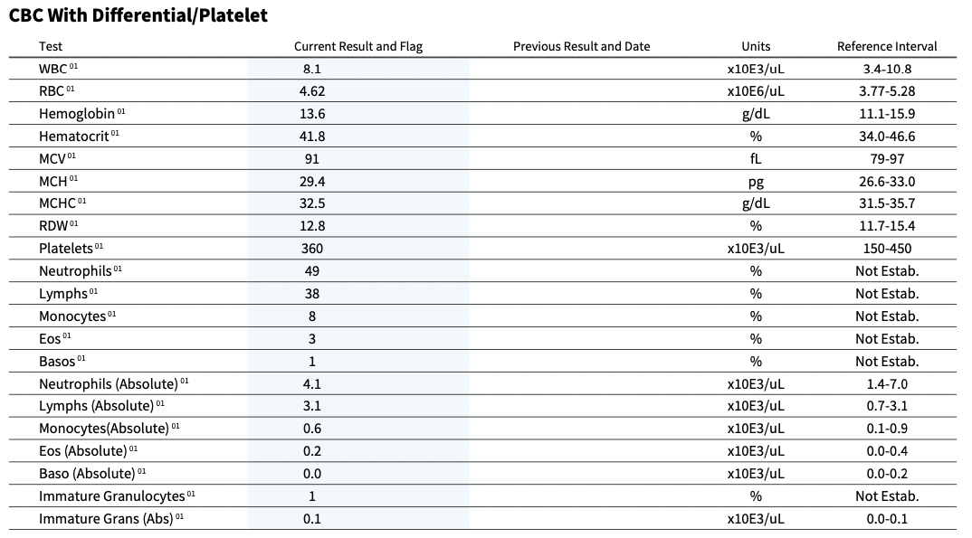

Slide 17
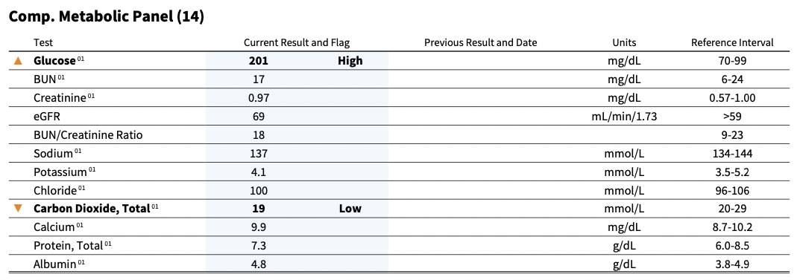

Slide 18
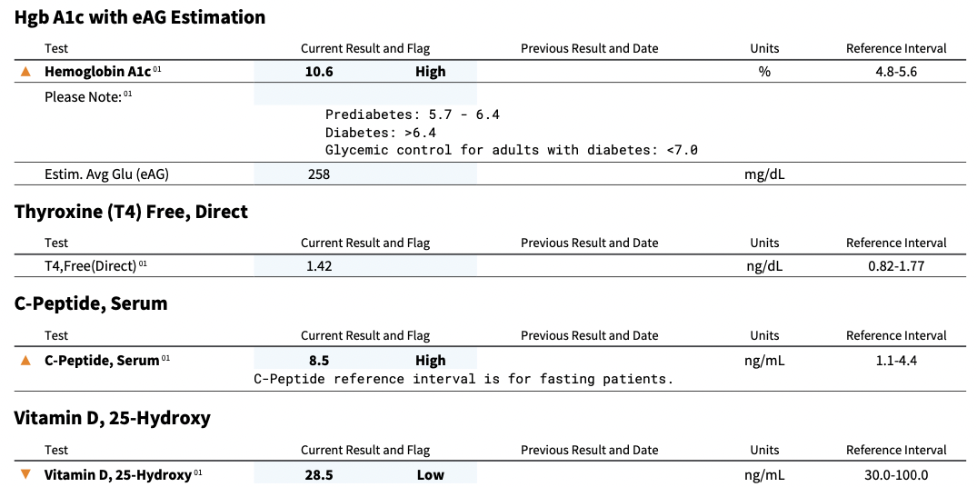

Slide 19
Urine Studies
The following studies are recommended to screen for reversible causes of neuropathy:
Heavy metal screen (Hg, Pb, Zn, As)
Urine protein electrophoresis, urine immuno-electrophoresis
*Chest x-ray, helpful to screen for asymptomatic lung cancer that can sometimes cause a purely sensory neuropathy.
https://www.urmc.rochester.edu/MediaLibraries/URMCMedia/center-experiential-learning/cme/types-of-activities/documents/PERIPHERAL-NEUROPATHY-HANDOUT.pdf

Slide 20
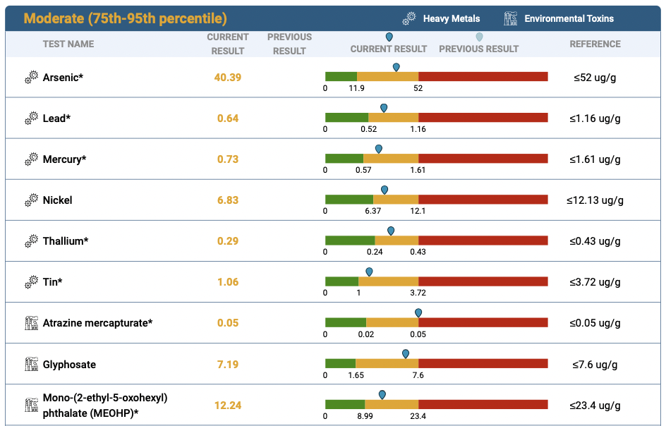
59-year-old, female, dx c/ diabetes

Slide 21
Anticonvulsants, Gabapentin
Tricyclics, Depression meds
NSAIDS, Hydroxychloroquine
Antidiabetic medications
Corticosteroids
Immunosuppressives, Methotrexate
???

