Slide 1
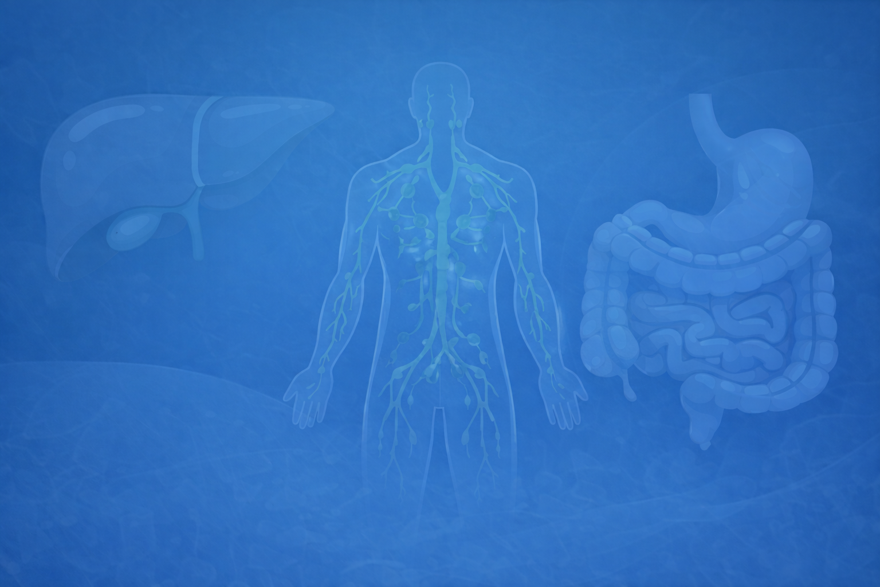

Casual Friday Series
Melatonin: Beyond Sleep
The Circadian Regulator of Gut, Immune, & Metabolic Health
A BIOGENETIX CLINICAL PRESENTATION
biogenetix.com

Slide 2


Disclaimer
Information in this presentation is not intended, in itself, to diagnose, treat, reverse, cure, or prevent any disease. While this presentation is based on medical literature, findings, and text, The following statements have not been evaluated by the FDA.
The information provided in this presentation is for your consideration only as a practicing health care provider. Ultimately you are responsible for exercising professional judgment in the care of your own patients.

Slide 3
How many times have we seen it?
Patient’s anxiety is rising… autoimmune flares are rising… metabolic numbers are stuck
They “sleep” 7–8 hours but wake up exhausted
They’ve tried every protocol — yet still plateau
You’ve watched the CF’s… L-Theanine helps the racing thoughts and somatic symptoms… but a few weeks later the anxiety, fatigue, or autoimmune flare comes roaring back.
Why? Because we are missing the “timer” and their circadian rhythm is broken

Slide 4
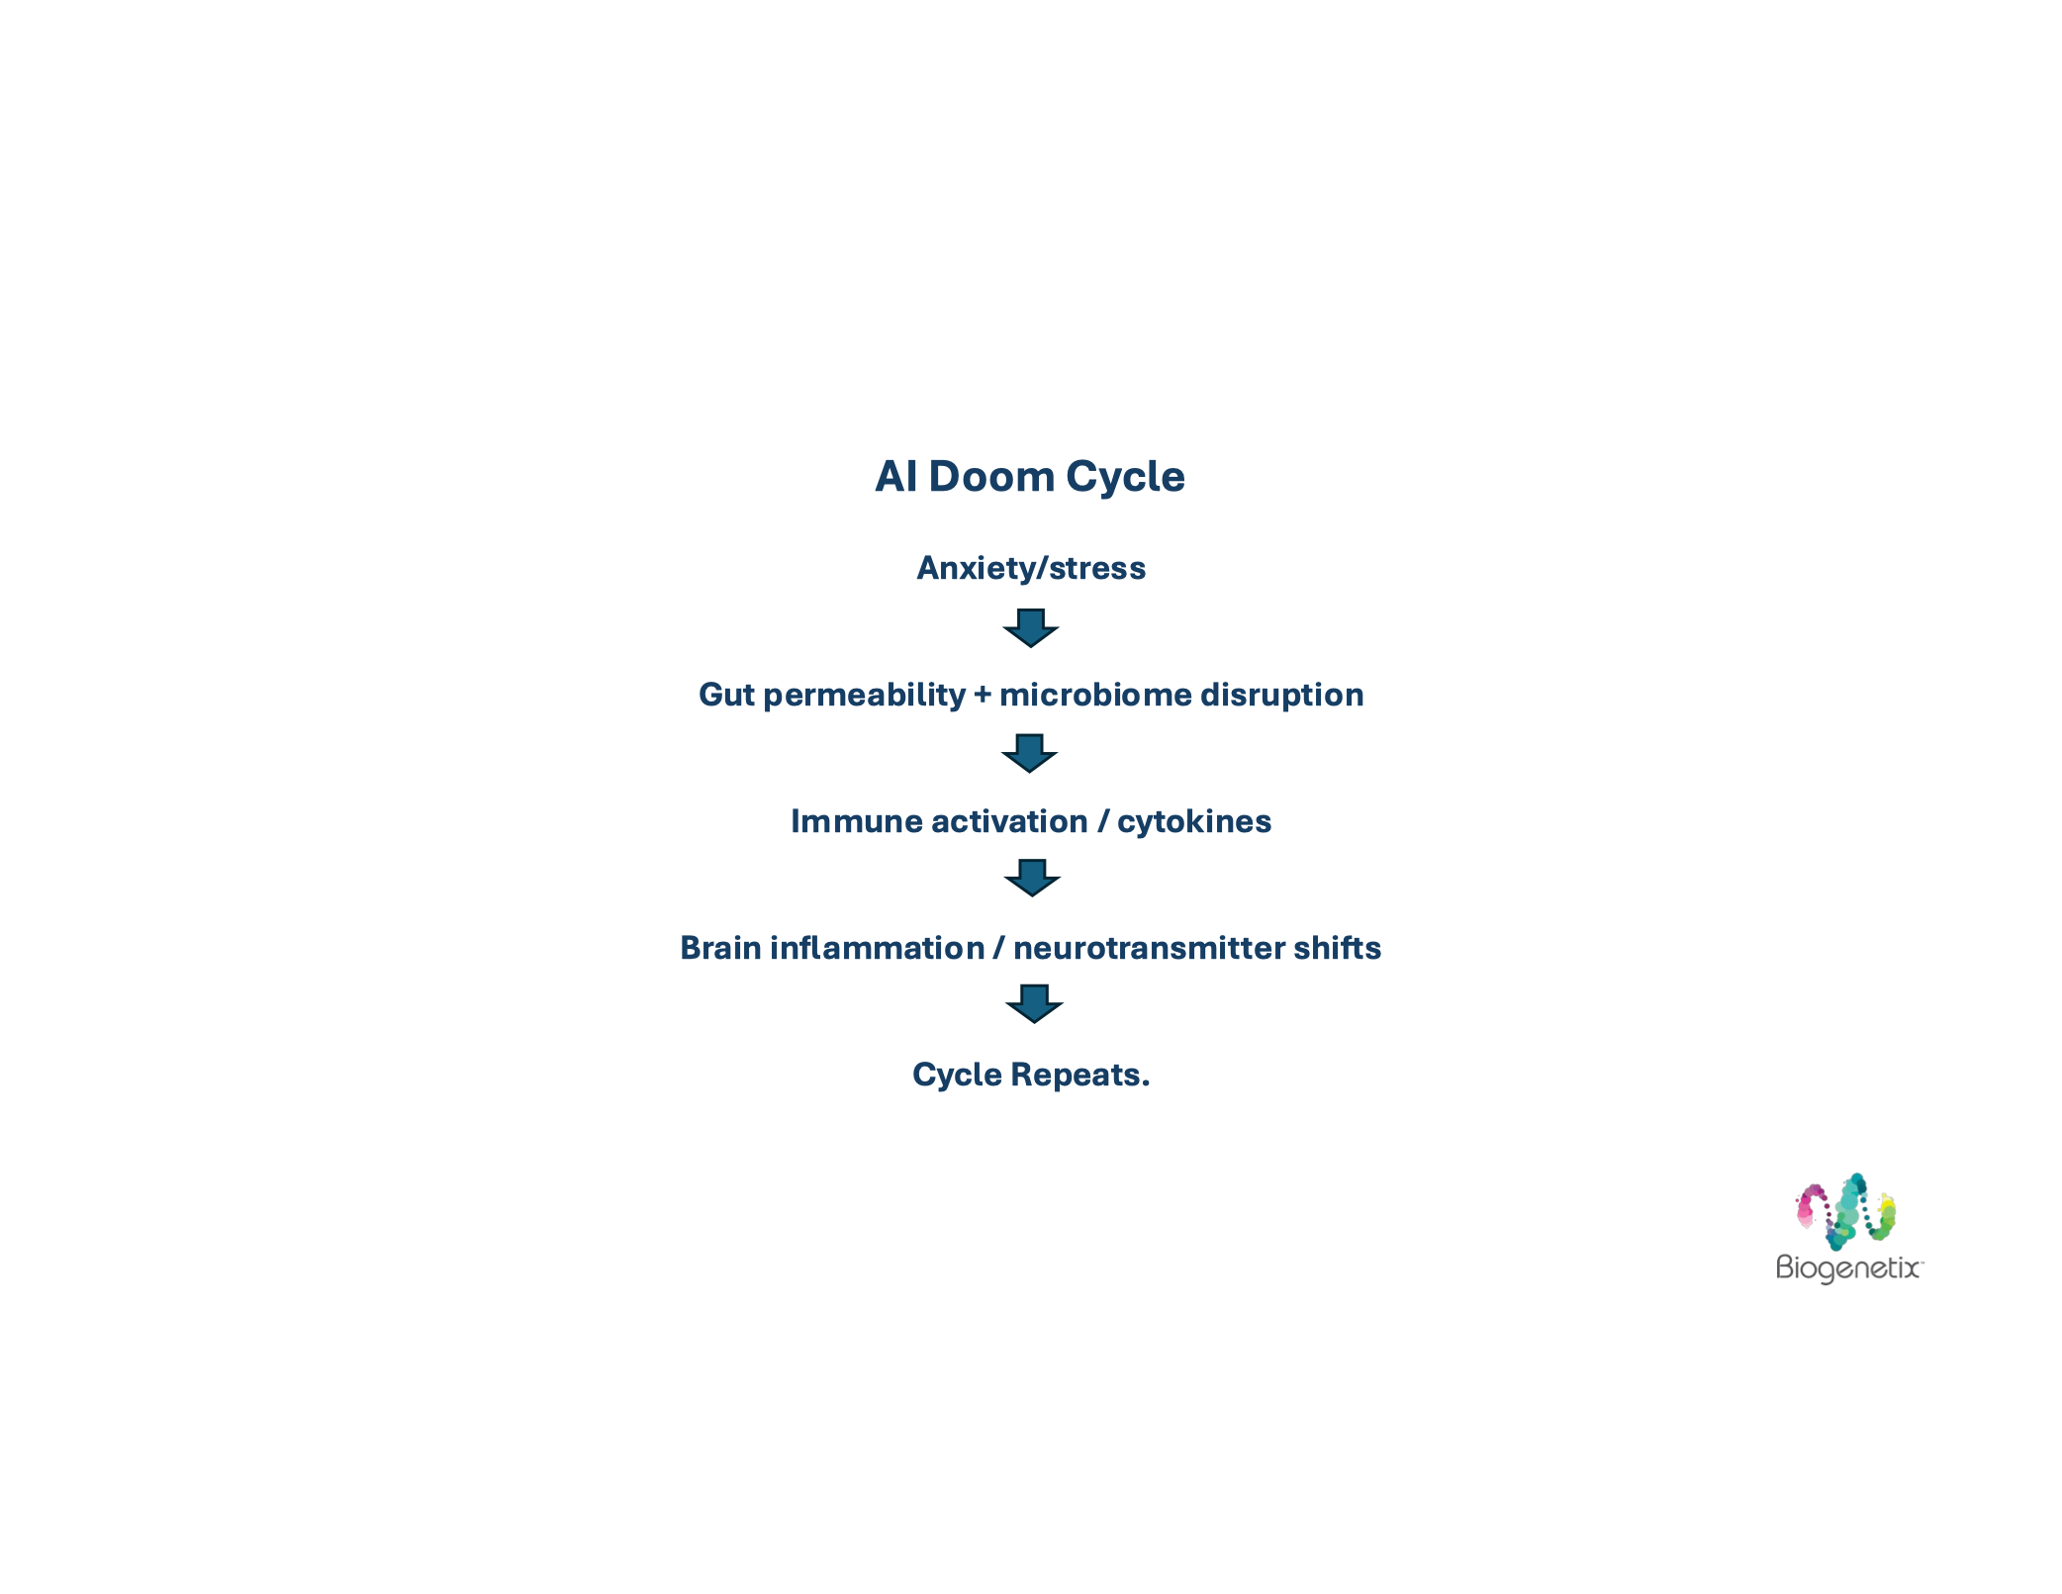
Dr. Watts showed us the AI Doom Cycle
Today we’re going to discuss an overlooked missing piece that has the potential to break that cycle at the source: The circadian rhythm and melatonin — the molecule that is *not* just a sleep aid, but the circadian regulator of gut, immunity, and metabolic health.”

Slide 5
Melatonin Is NOT Just a Sleep Aid
Melatonin is a mitochondrial, immune, metabolic, and gut signaling molecule
Melatonin is produced in the…
Pineal gland
Gut mucosa
Immune cells
Mitochondria themselves
Most of the melatonin that actually matters in chronic disease is made right where the problem is — in the gut and the mitochondria.
Notes:
“Dr. Watts already showed how inflammation drives the high-inflammation anxiety subtype (p.8-10 of his deck). Melatonin is the molecule that modulates that inflammation on a 24-hour schedule

Slide 6
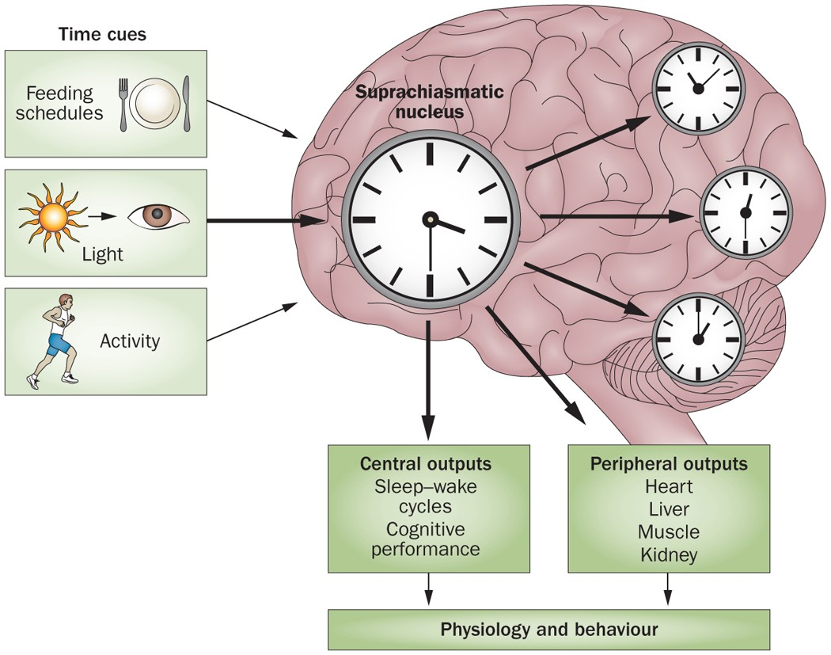
Circadian Biology and Cortisol
Suprachiasmatic nucleus (SCN) = master clock
• Morning light → sets the rhythm
• Evening blue light / late eating → flattens the rhythm
Melatonin rises as cortisol falls — they are inverse

Slide 7
When the Rhythm Breaks
The Cortisol Curve Flattens… ie high night-time cortisol
This flattened cortisol curve = exactly what Dr. Watts showed in the high-inflammation and stress-sensitized subtypes
Who is more prone: Shift workers, screen junkies, late-night eaters
The Result ↑ anxiety, ↑ autoimmune flares, ↑ insulin resistance
Many of your “anxious” patients aren’t anxious — they’re circadian-misaligned.

Slide 8
Melatonin as Immune Modulator
This should sound familiar…
Down-regulates NF-κB
Lowers IL-6, TNF-α
Supports regulatory T-cells
Dual role: can be stimulatory or calming depending on dose & timing

Slide 9

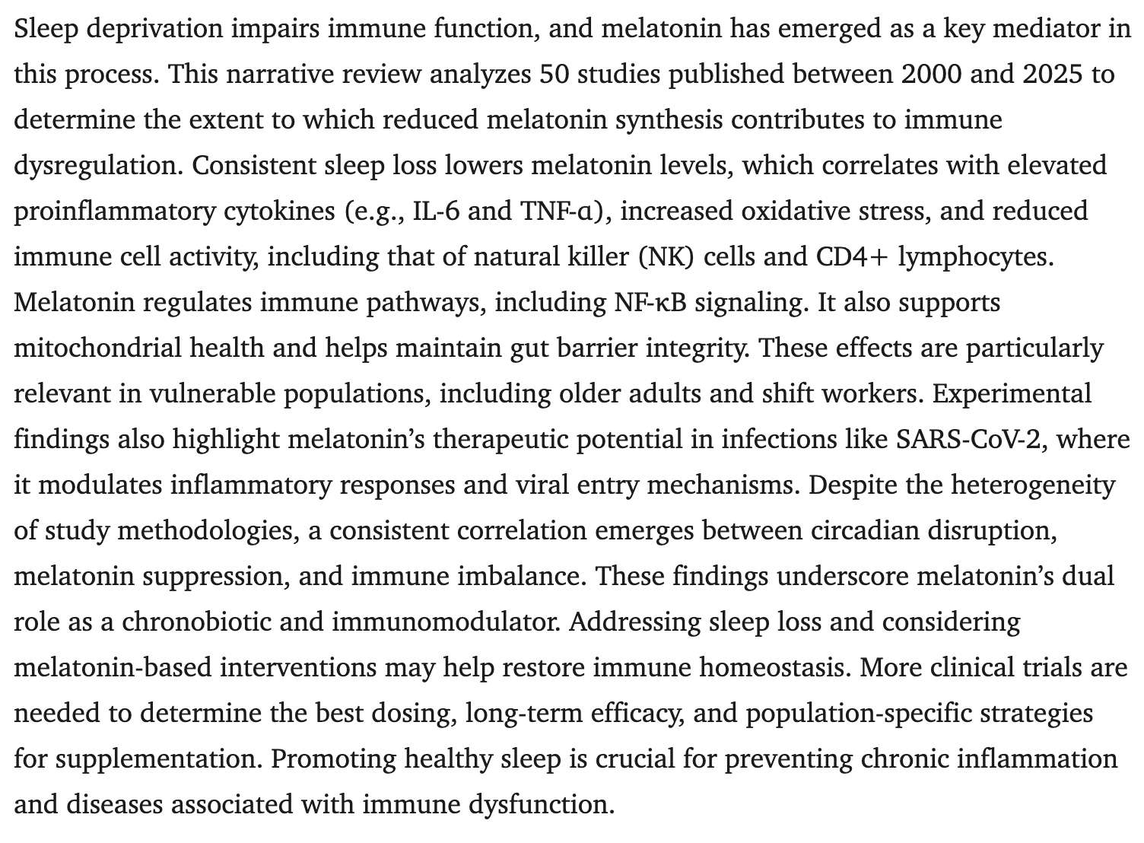

Slide 10
The Gut–Melatonin Connection
Gut produces far more melatonin than the pineal gland… about 400× more melatonin than pineal gland
Regulates motility, tight junctions, microbiome balance
Reduces intestinal permeability
Protects against the stress “bulldozer”
Food-responsive (late eating = gut melatonin chaos)
Clinically we can see IBS, SIBO, IBD, nighttime reflux, and leaky gut

Slide 11
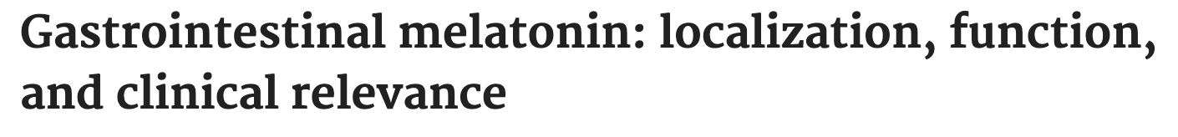
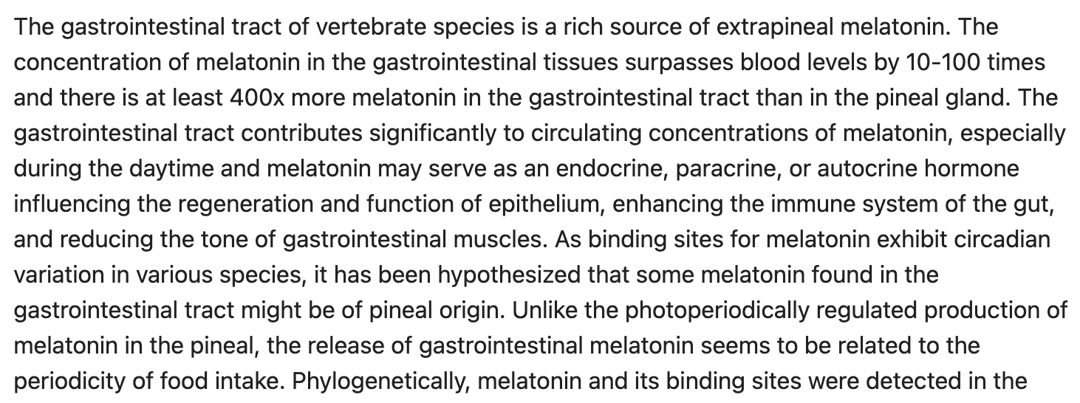

Slide 12
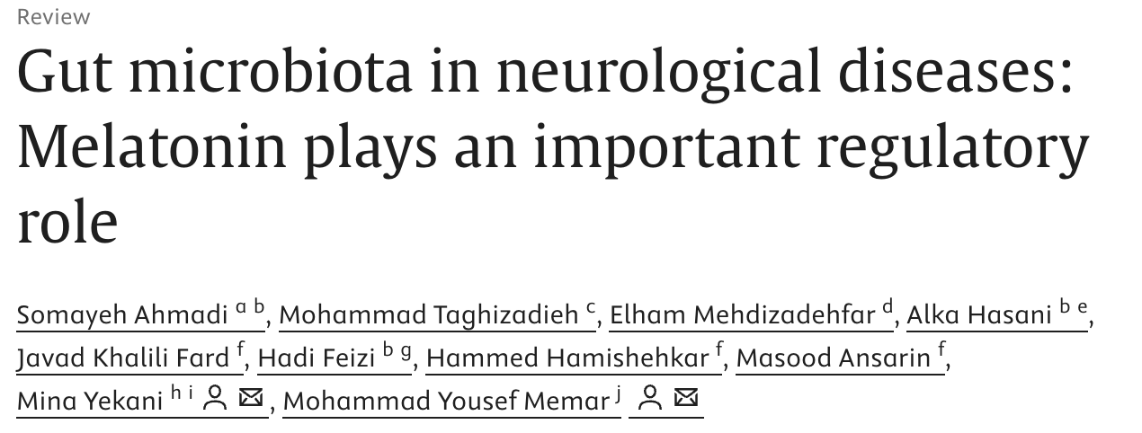
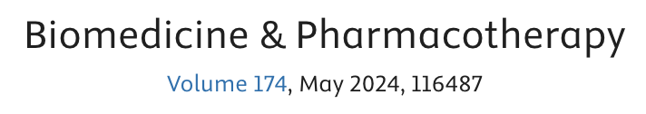
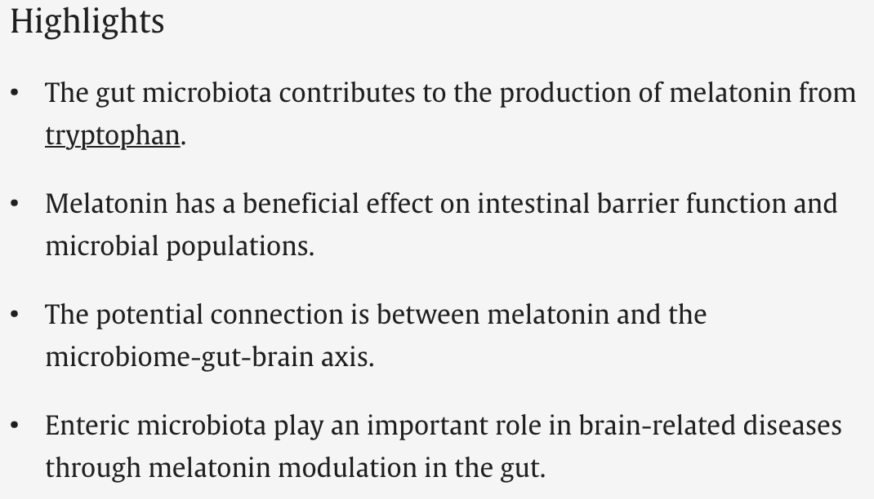

Slide 13
Blood Sugar & Metabolic Regulation
MT1 & MT2 receptors on pancreatic beta cells sense melatonin
At night, high melatonin, decreases insulin secretion (protective)
Inhibits cAMP pathway: prevents excess insulin during fasting/rest
Keeps glucose steady for brain overnight without over-insulinizing
Late-night eating while melatonin high → overrides protection
Carbs + elevated melatonin = blunted insulin response
Result: worse glucose tolerance, higher spikes, prolonged elevation
Shift workers & late eaters fight natural rhythm → higher diabetes/metabolic risk
Misaligned timing disrupts the protective nightly "insulin brake"
Notes:
"Dr. Watts' inflammation tree has metabolic branches like obesity, NAFLD, diabetes — huge when chronic inflammation is the trunk. But the timing lock that keeps them stuck is right here in the pancreas. Beta cells have melatonin receptors (MT1/MT2).
Naturally, melatonin rises at night and dials **down** insulin via the cAMP pathway. This is protective — it stops the pancreas from pumping out insulin when you're fasting and resting, keeping blood sugar stable for your brain without risking lows or excess storage. Studies confirm this inverse rhythm: melatonin up, insulin secretion down at night.
The problem hits when we eat against that clock — late dinner or snack while melatonin is already high. Now the protective suppression becomes a mismatch: insulin response is blunted, glucose hangs around longer, tolerance tanks. That's why late eating worsens glycemic control in real patients.
Shift workers live this every day — eating/working when the body expects rest/fasting → higher risk for metabolic issues and diabetes. This is classic metabolic inflexibility: fighting your own biology.
Clinical pearl: Start here — no labs needed. Ask about meal timing, evening habits. Push early eating windows (finish 3 hrs before bed), morning light, dim evenings. When the rhythm aligns, the tree branches lighten up — energy improves, weight moves, detox flows better. Our clearing tools restore capacity so the fix sticks."

Slide 14
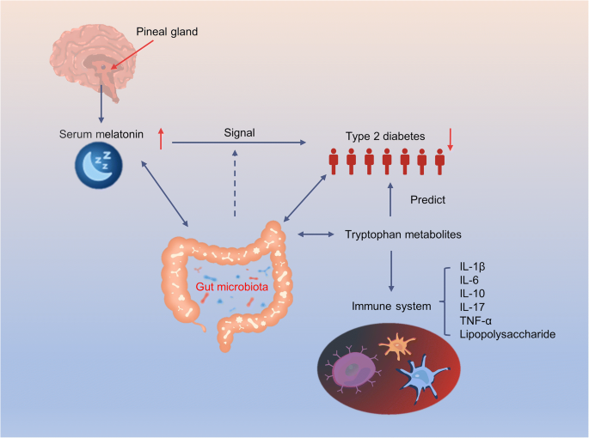

Slide 15
Mitochondria, Oxidative Stress & Brain Drainage
Direct free-radical scavenger (better than glutathione in some tissues)
Upregulates glutathione & superoxide dismutase (SOD)
Protects mitochondrial DNA
Deep sleep = glymphatic clearance (brain’s lymphatic drainage)
Deep sleep = glymphatic clearance. Without it, the brain inflammation and Doom Cycle never clears.
Notes:
Melatonin doesn't just scavenge radicals directly — it upregulates your own defenses like glutathione (GSH) and SOD — superoxide dismutase — the enzyme that mops up superoxide radicals before they damage mitochondria. Studies show it boosts SOD activity and expression, especially in stressed tissues, so the cell's antioxidant system stays robust long-term.

Slide 16
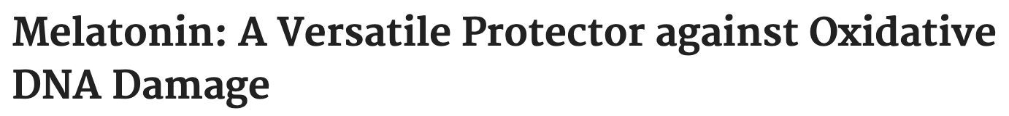
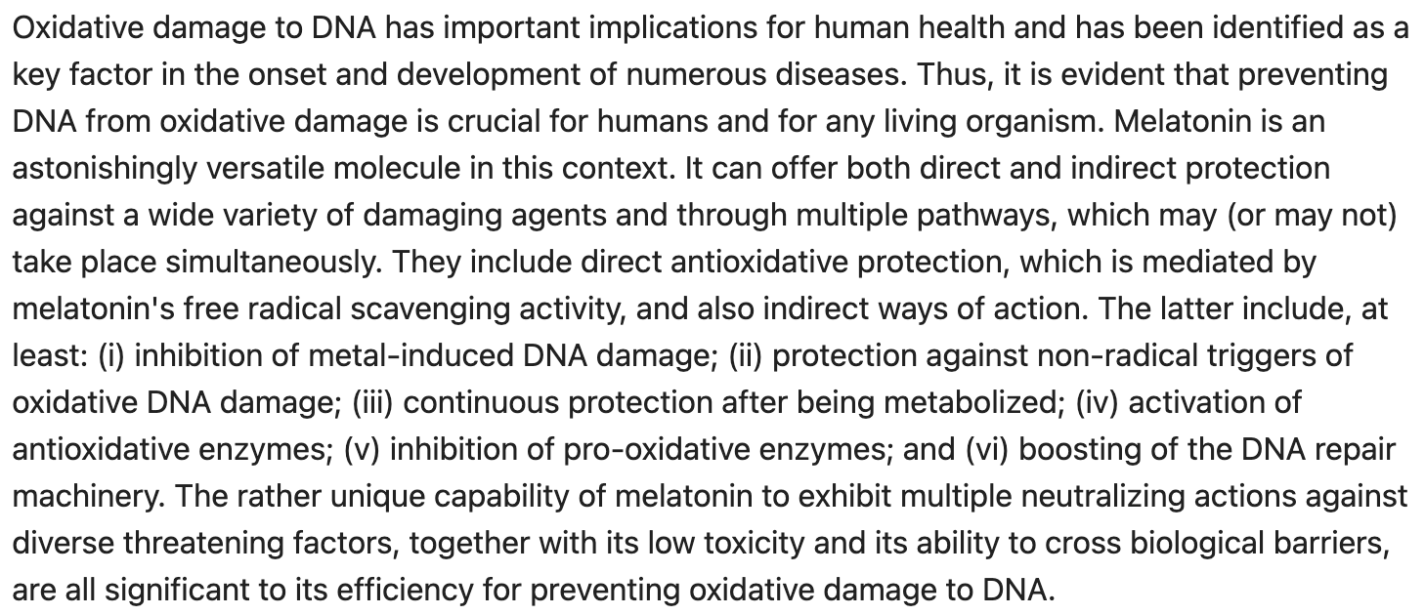

Slide 17
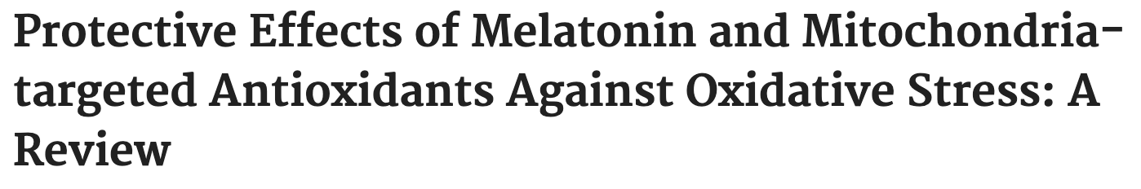
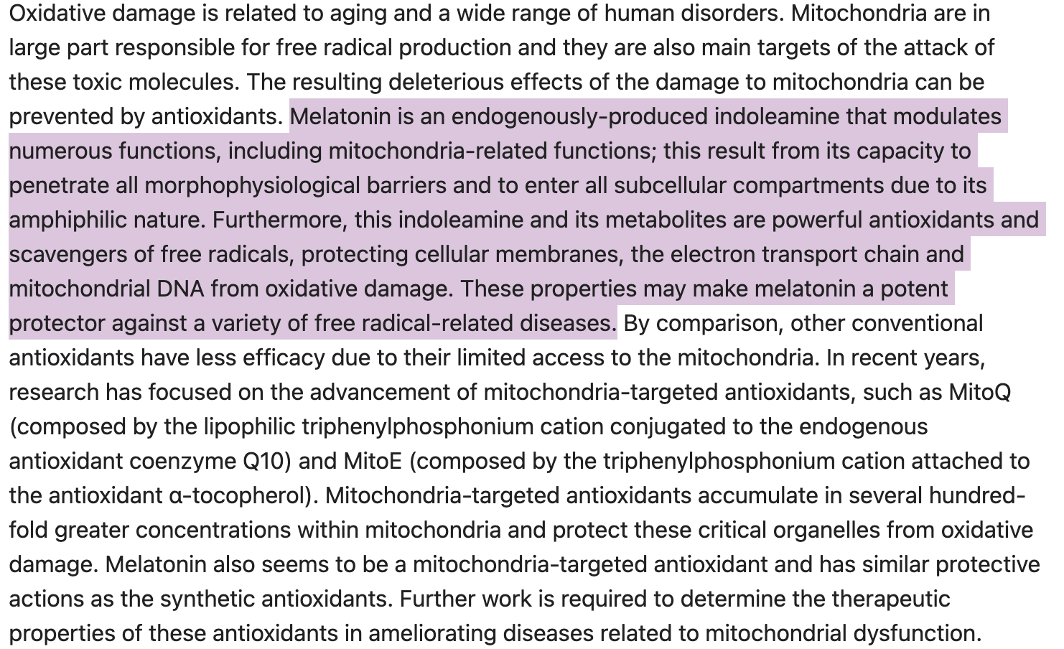

Slide 18
Spotting Circadian Disruption in Practice (no fancy labs needed)
Wakes between 2–4 a.m. → night-time cortisol spike
Can’t fall asleep before 11 p.m. despite exhaustion
Morning grogginess that lasts >30 min
Nighttime reflux or sugar cravings
Poor response to otherwise good protocols
Poor sleep + somatic symptoms + autoimmune comorbidity = high-inflammation subtype from Dr. Watts

Slide 19
Dosing & Timing
Lifestyle First — Always
• Morning sunlight (10–30 min)
• Evening darkness / blue-light block after sunset
• Stop eating 3 hrs before bed
• Consistent sleep/wake times

Slide 20
Dosing & Timing
Physiologic Dosing (Circadian + Gut/Mito Support)
0.3 – 1 mg
60–90 min before desired bedtime (or up to 3 hrs for stronger circadian shift)
Immediate-release preferred — mimics natural rise
Standard Clinical Dosing (Most Patients)
Start 0.5 – 3 mg
Titrate to 5 mg max if needed
30–60 min before bed (immediate for onset, extended for maintenance)

Slide 21
Dosing & Timing
Research / Targeted Dosing (Autoimmune, Metabolic, Oxidative Stress)
Hashimoto’s, IBD, MS: 3–6 mg nightly (bedtime)
RA & metabolic support: 6–10 mg nightly
Higher mito/antioxidant contexts (elderly/comorbid): 10–40+ mg (well-tolerated in studies up to 200 mg)
Key Takeaway
Lower physiologic doses timed correctly support the local gut + mitochondrial melatonin that actually drives immune and metabolic benefits. We don’t need to flood the system — we support the rhythm.

Slide 22
Cautions & When NOT to Use
Short term usage is preferred
Pregnancy
Severe depression (can worsen in some)
Autoimmune patients on high-dose immunosuppression
Kids — use lowest effective dose
0.5–3 mg max

Slide 23
Clinical Integration
1. Considerations from other CFs
- Root To Fruit (stress, gut, antigenic cloud)
- Calm the anxious brain/gut with L-Theanine
- Repair leaky gut & cytokines (high-inflammation subtype focus)
2. Restore Circadian Capacity
- Morning sunlight 10–30 min
- Evening darkness / blue-light block
- Stop eating 3 hrs before bed (protect gut melatonin pool)
- Consistent sleep/wake times
3. Add Timed Melatonin if Needed
- Physiologic: 0.3–1 mg (60–90 min before bed) for local gut/mito support
- Clinical: 1–3 mg (or 3–6 mg for autoimmune/IBD/MS overlap)
- Immediate for onset; extended for maintenance
- Melatonin supports the rhythm, doesn’t replace it
Notes:
“Dr. Watts nailed the **what**: the inflammation tree, antigenic cloud, leaky gut driving anxiety and autoimmune flares, and L-Theanine as the quick calmer for the high-inflammation subtype.
We’re adding the **when**: circadian timing. Without the rhythm, protocols stall — patients improve a bit, then plateau again.
So in practice:
1. Hit the foundations first — calm with L-Theanine, repair gut, reduce cytokines.
2. Build capacity with basics: morning sun, evening dark, early eating window. This alone boosts endogenous melatonin, especially the gut pool we talked about.
3. If sleep onset/maintenance or nighttime cortisol is still off, layer in physiologic melatonin timed right — low dose supports local production in gut/mito without overriding.
4. Then stack the Biogenetix tools:
This sequence lets the clock do its job long-term. Fix timing → inflammation eases, gut holds, metabolism flows, anxiety quiets. The tree branches lighten up when the root (chronic inflammation) gets drained and timed right.
Questions? How many of you already ask about meal timing in autoimmune patients?

Slide 24
How Biogenetix Supports the Foundation
Hypaax Balance: restores healthy HPA-axis & cortisol rhythm
BioG-Max GABA: calms evening nervous system tone, supports parasympathetic wind-down
BioG-Max GSH + CoQ10: mitochondrial antioxidant protection & energy production (synergizes with local mitochondrial melatonin)
Binder Pro: binds LPS & gut-derived toxins, supports barrier integrity (protects the gut melatonin factory)
Metabolic Clearing Kit: full-system inflammation reset & drainage capacity (liver, lymph, gut)

Slide 25
You can not fix the inflammation without fixing the timing.
Melatonin isn’t the hero… the Circadian Rhythm is!

