Slide 1
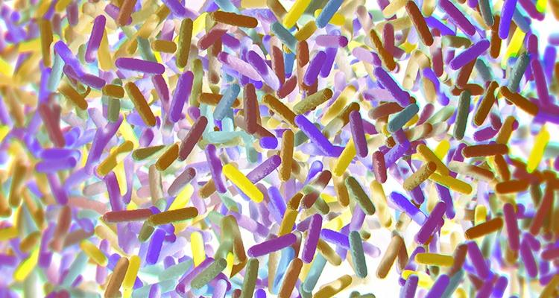

Casual Friday Series
When Healthy Foods Stress The Body
A functional look at ferments, histamine, and metabolic resilience
A BIOGENETIX CLINICAL PRESENTATION
biogenetix.com

Slide 2


Disclaimer
Information in this presentation is not intended, in itself, to diagnose, treat, reverse, cure, or prevent any disease. While this presentation is based on medical literature, findings, and text, The following statements have not been evaluated by the FDA.
The information provided in this presentation is for your consideration only as a practicing health care provider. Ultimately you are responsible for exercising professional judgment in the care of your own patients.

Slide 3
Why Are Patients Reacting to Foods?
Sourdough, kombucha, kefir, probiotic sodas, and fermented vegetables are now widely seen as “healthy upgrades” or health halo foods
These foods have moved from niche wellness products into mainstream staples
Yet patients may still report:
bloating
headaches
skin flares
fatigue
blood sugar instability
A healthy reputation does not guarantee a healthy response.
These foods have a strong health halo right now. Patients are adding them because they expect improvement, but in practice many still feel worse.

Slide 4
Resilience Determines Response
Same food → different patient outcomes
Depends on:
gut resilience
histamine resilience
metabolic resilience
detox/drainage resilience
It’s not just the food — it’s the system receiving it.
Two patients can eat the same food and get opposite outcomes. The variable is not always the food itself. The variable is the resilience of the person eating it.

Slide 5
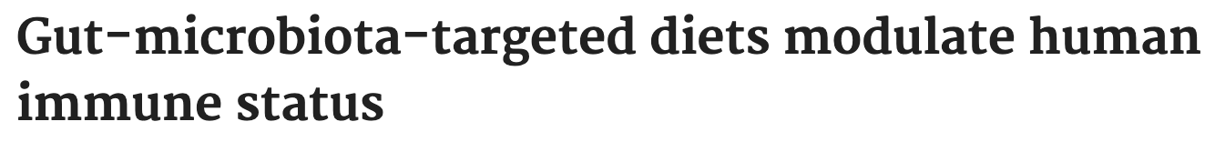
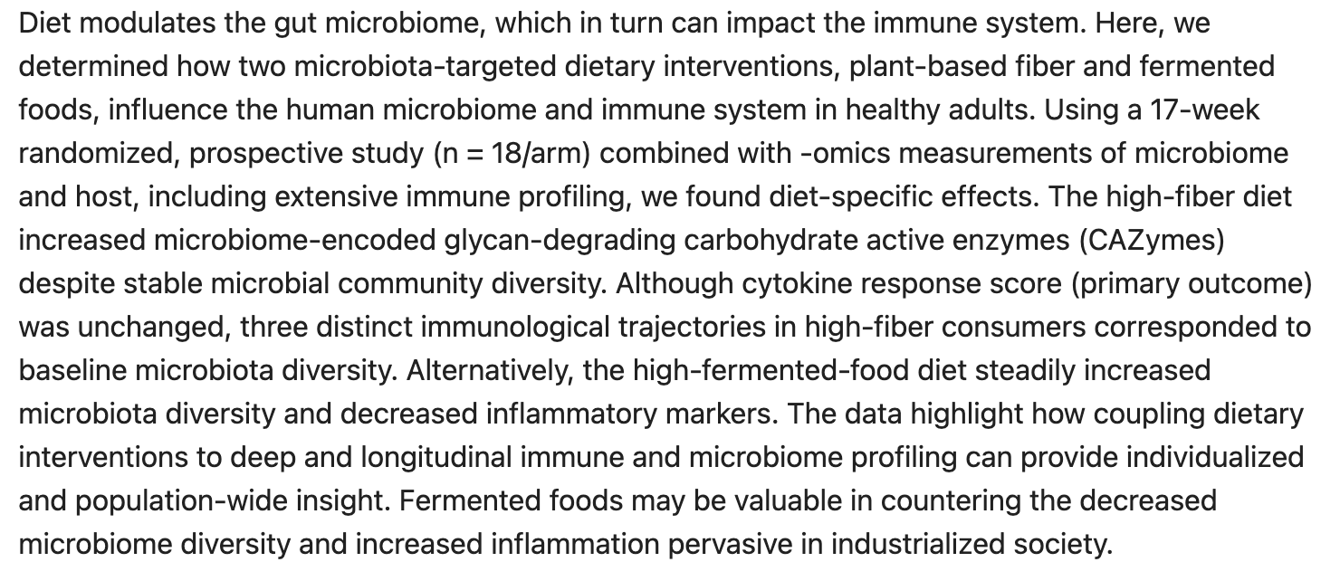

Slide 6
Ferments Can Help - But Not Universally
What we get from this article:
Fermented food diets increased microbiome diversity
19 inflammatory proteins decreased, including IL-6
Important Observation:
Benefits occurred in selected individuals—not universally.
Ferments can be therapeutic—but only when the terrain is ready.

Slide 7
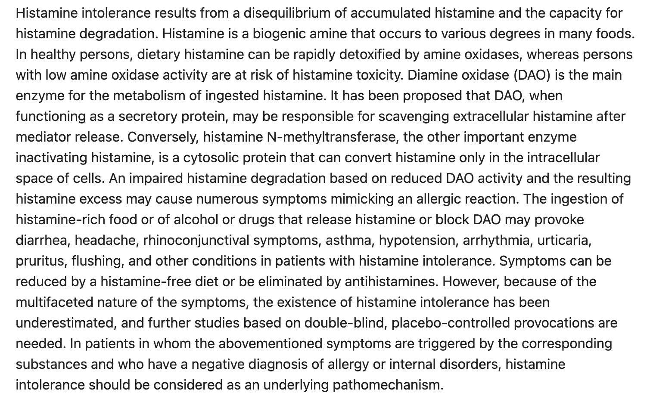

Slide 8
When Ferments Become a Histamine Stressor
Fermented foods are high in histamine, tyramine, and other biogenic amines
Histamine intolerance reflects imbalance between histamine load and degradation capacity
Common symptoms:
headaches
flushing
anxiety
skin reactions
The issue is often not the food alone — it’s impaired clearance.
If the client’s bucket is already full, healthy ferments can become symptom triggers. This is where resilience starts to matter clinically.

Slide 9
Kombucha, Kefir and Probiotic Drinks
Same Category, Different Stressors
Kombucha
Histamine-rich
Often contains residual sugar
Acidity may irritate sensitive GI systems
Kefir
Often better tolerated
Different microbial strains
Dairy proteins may still create problems in some patients
Probiotic drinks / sodas
Marketed as gut-supportive
May have low true microbial potency
Can still add sugar load
These products are marketed similarly, but they do not behave the same physiologically.

Slide 10
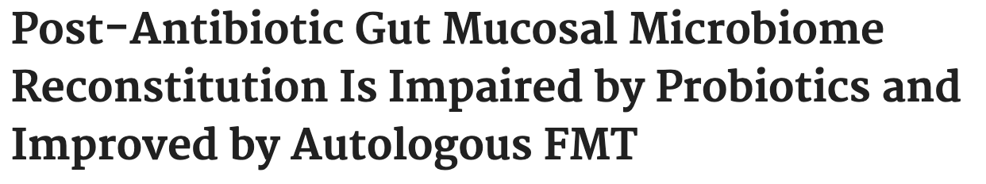
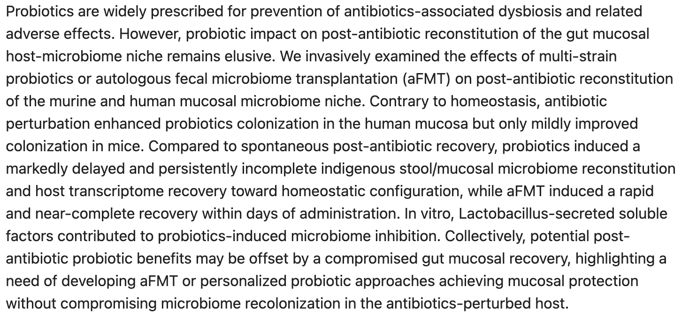

Slide 11
Kombucha, Kefir and Probiotic Drinks
Research Notes:
Probiotic colonization is highly individualized
Host microbiome and immune environment matter
Some may even see a delay in recolonization
This is why I would not lump all ferments together. Kombucha, kefir, and probiotic beverages may all sit in the same aisle, but they create very different kinds of stress and impact.

Slide 12
Sourdough is Not a Free Pass
Sourdough fermentation may:
Reduce phytates
Improve digestibility
Partially degrade gluten peptides
But sourdough still:
Contains residual gluten proteins
Drives glucose response
Stimulates insulin demand
May trigger immune signaling in susceptible patients
Improved digestibility does not equal metabolic neutrality.
Sourdough may be modified bread, but it is still bread. It may be better tolerated in some cases, but it is not consequence-free.

Slide 13
Why Sourdough Still Matters Metabolically
Modern grain products may contribute to:
Blood sugar volatility
Insulin signaling burden
Gluten/WGA immune stimulation
Agricultural residue exposure
Cumulative inflammatory load
Food impact is shaped by total inflammatory burden — not just its health reputation.
This is no longer just a digestion conversation. For many patients, grain exposure carries metabolic, immune, and environmental burden all at once.

Slide 14

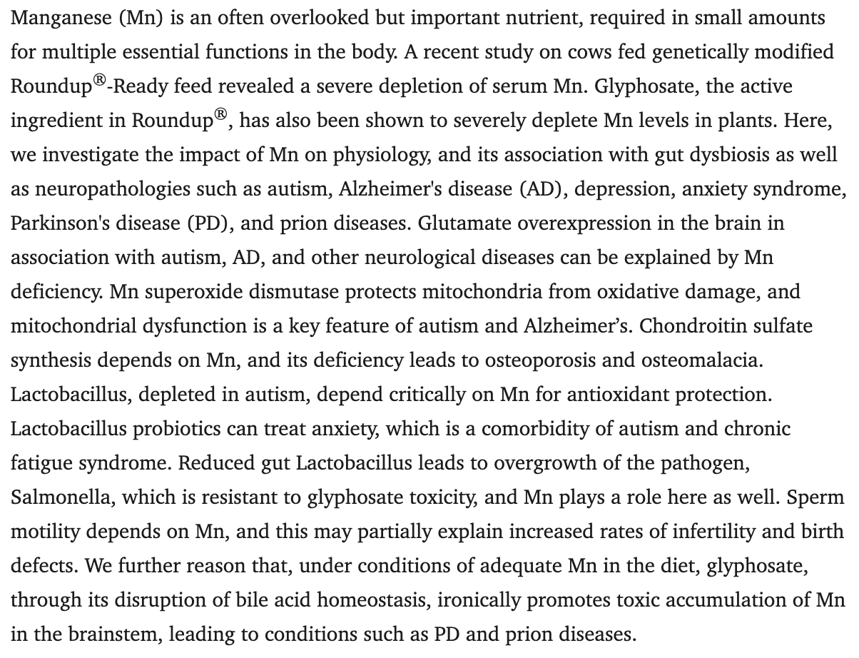

Slide 15
Healthy Foods, Same Toxic Environment
For metabolically fragile patients, the issue is cumulative burden: glycemic load, immune activation, and environmental exposure all layered together.
A resilient system may tolerate this well—a compromised one often cannot.

Slide 16
Real Problem is Reduced Resilience
Low resilience creates exaggerated responses:
Histamine overload
Dysbiotic flare-ups
Blood sugar instability
Inflammatory signaling
Functional Root Causes:
Impaired drainage
Gut barrier dysfunction
Chronic inflammation
Insulin resistance
When resilience is low, even healthy foods become stressors.
We’re back to the main point now. The food may reveal the problem, but the deeper issue is reduced resilience

Slide 17
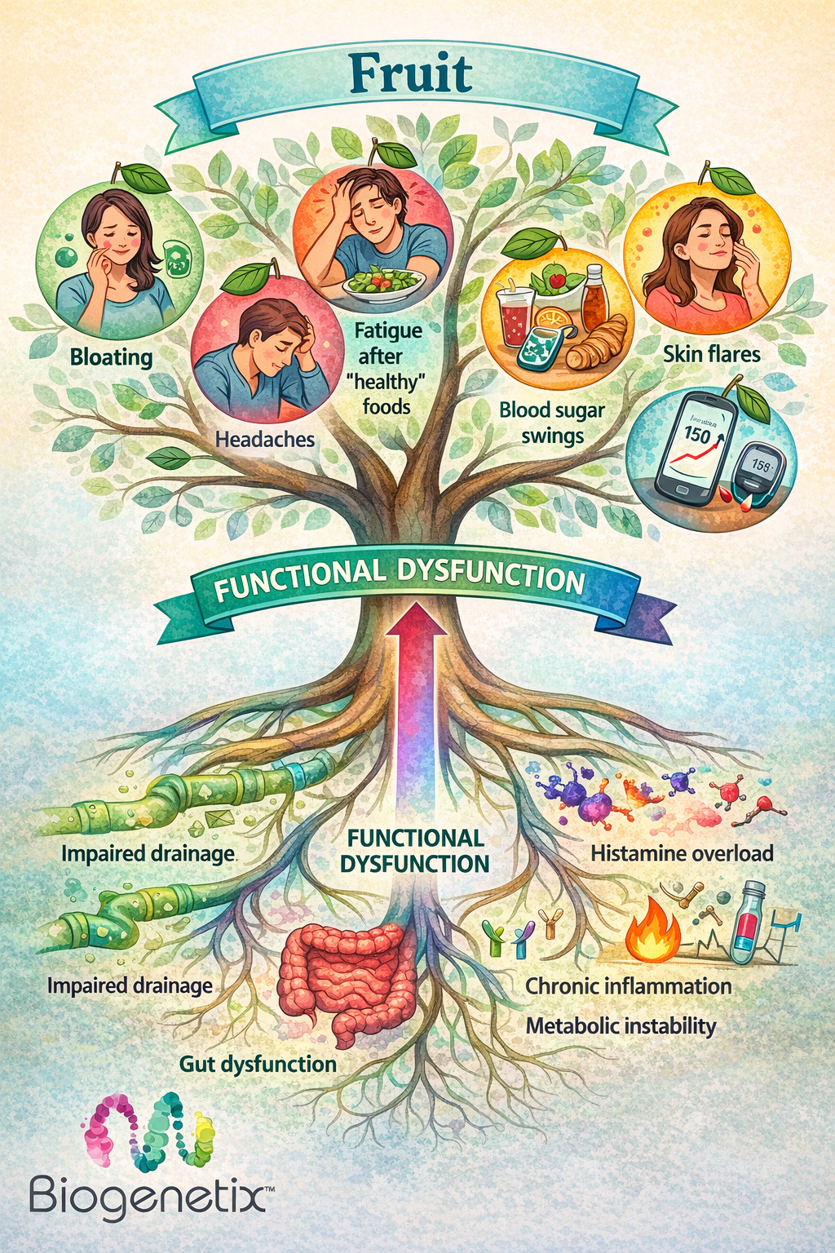
Symptoms are feedback, not random events.
When a patient reacts to healthy foods, I do not see that as random intolerance. I see it as physiology giving us information.”

Slide 18
What to Look For Clinically
Look for patterns in:
Fasting insulin
CRP
Homocysteine
Liver enzymes
CBC inflammatory trends
Normal labs may still hide poor resilience patterns.
Many of these patients have labs that look acceptable at first glance. The real value comes from pattern recognition.

Slide 19
Change the Conversation
Avoid:
“Stop eating that forever.”
Instead try things like:
“Let’s rebuild things first.”
“We need to lay the foundation first.”
Food removal is temporary; resilience rebuilding is the long-term strategy.
This changes patient psychology. We are not taking foods away as punishment. We are rebuilding tolerance with intention.

Slide 20
Build Resilience in Phases
Reduce overwhelm temporarily
Restore drainage pathways
Stabilize blood sugar
Repair gut integrity
Reintroduce ferments strategically
The goal is to build tolerance — not create permanent restriction.
The strategy is not to fear these foods forever. It is to rebuild the system so the patient can handle the physiological response.

Slide 21


Building Resilience with BioG
21 day MCP with Binder Pro
GI ResQ+ Bundle

Slide 22
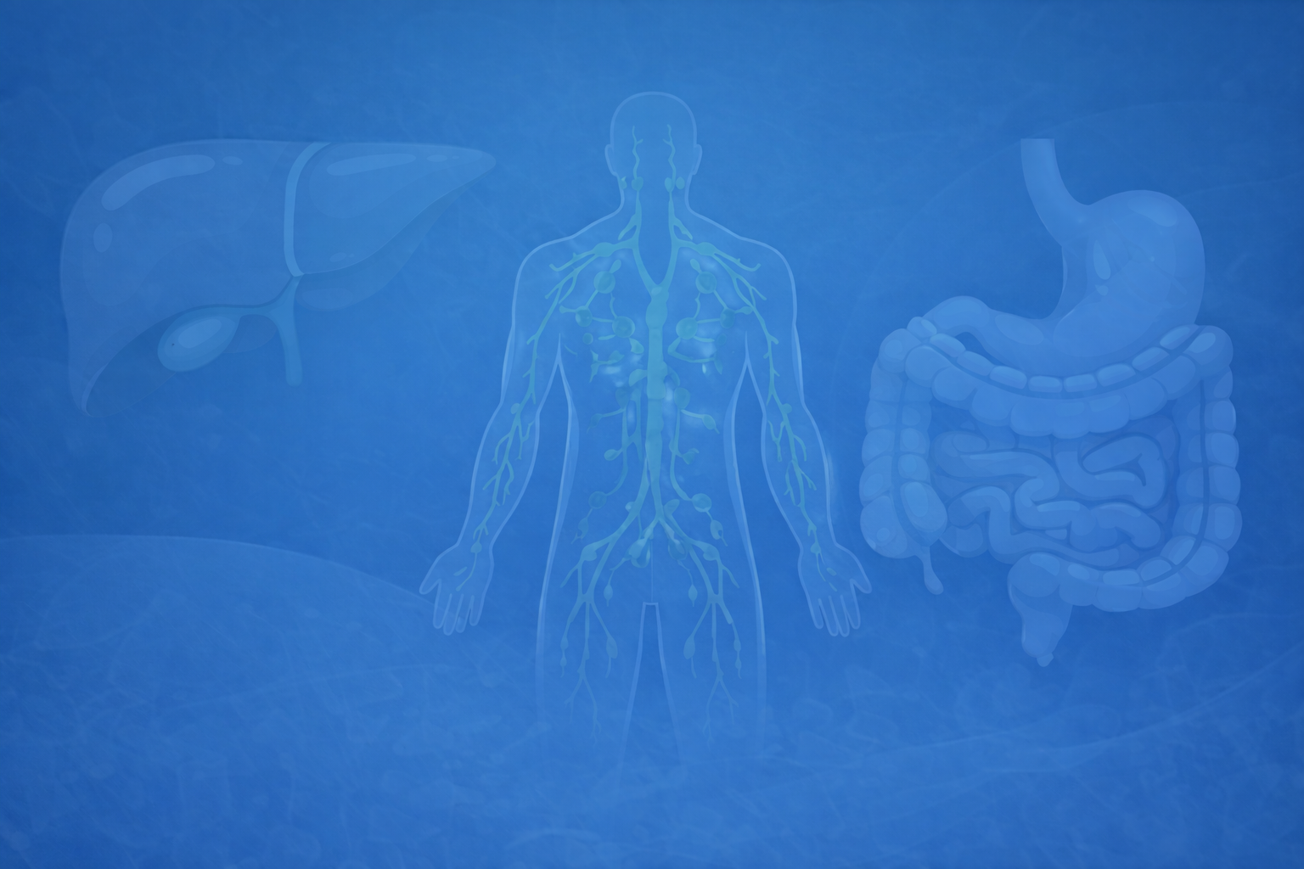
A food’s reputation does not determine its physiologic impact. The real goal is not perfect food selection — it is building a body that adapts well.

