Slide 1
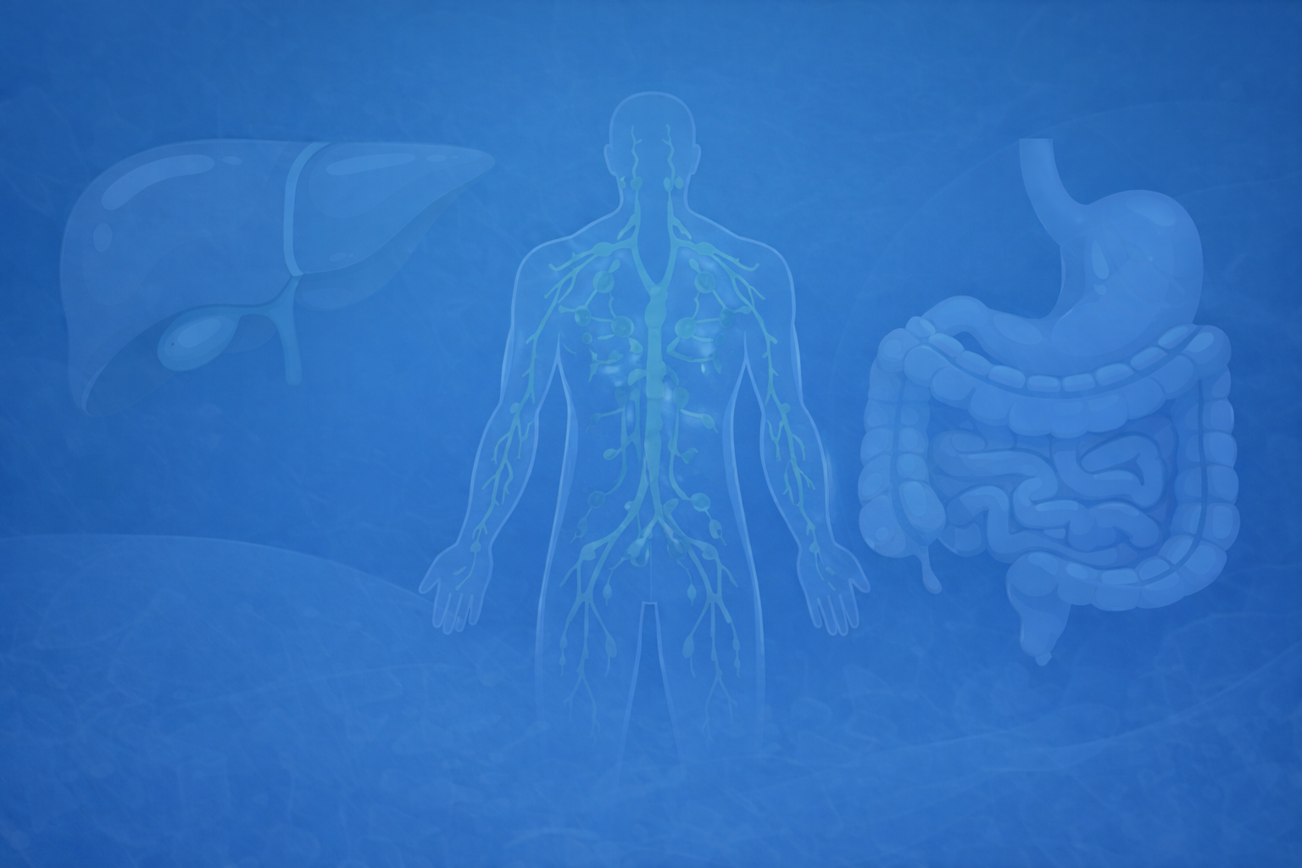
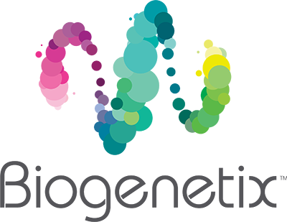
Casual Friday Series
Beyond the Data
Why Better Conversations Create Better Outcomes
A BIOGENETIX CLINICAL PRESENTATION
biogenetix.com
Notes:
We have more health information available today than ever before.
AI, wearables, lab software, podcasts, and social media have changed healthcare.
The challenge is no longer finding information. The challenge is helping patients understand what matters most.
Anchor: Patients don't need to know everything today. They need to know the next right step.

Slide 2

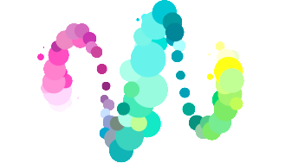
Disclaimer
Information in this presentation is not intended, in itself, to diagnose, treat, reverse, cure, or prevent any disease. While this presentation is based on medical literature, findings, and text, The following statements have not been evaluated by the FDA.
The information provided in this presentation is for your consideration only as a practicing health care provider. Ultimately you are responsible for exercising professional judgment in the care of your own patients.

Slide 3
Why Better Conversations Create Better Outcomes
We have more health information than ever before.
AI, wearables, lab software and social media have changed healthcare.
The challenge is no longer finding information.
The challenge is helping patients understand what matters most.
Great clinicians are becoming guides rather than information providers.
Notes:
* Healthcare has fundamentally changed.
* Information is becoming a commodity.
* Great clinicians are becoming guides rather than information providers.
Clinical Pearl
Patients don't need to know everything today.
They need to know the next right step.

Slide 4
Healthcare Has Changed
Patients now arrive with:
• AI recommendations
• Oura Ring data
• Apple Health metrics
• Functional lab reports
• Social media advice
• Endless supplement recommendations
INFORMATION IS EVERYWHERE. CLARITY IS NOT.
Notes:
This isn't a bad thing—I use many of these tools myself.
AI and wearables are incredible resources.
But more information doesn't automatically lead to better decisions.
Our role as practitioners is changing.
Technology is excellent at gathering information.
It cannot replace understanding the patient's story.

Slide 5
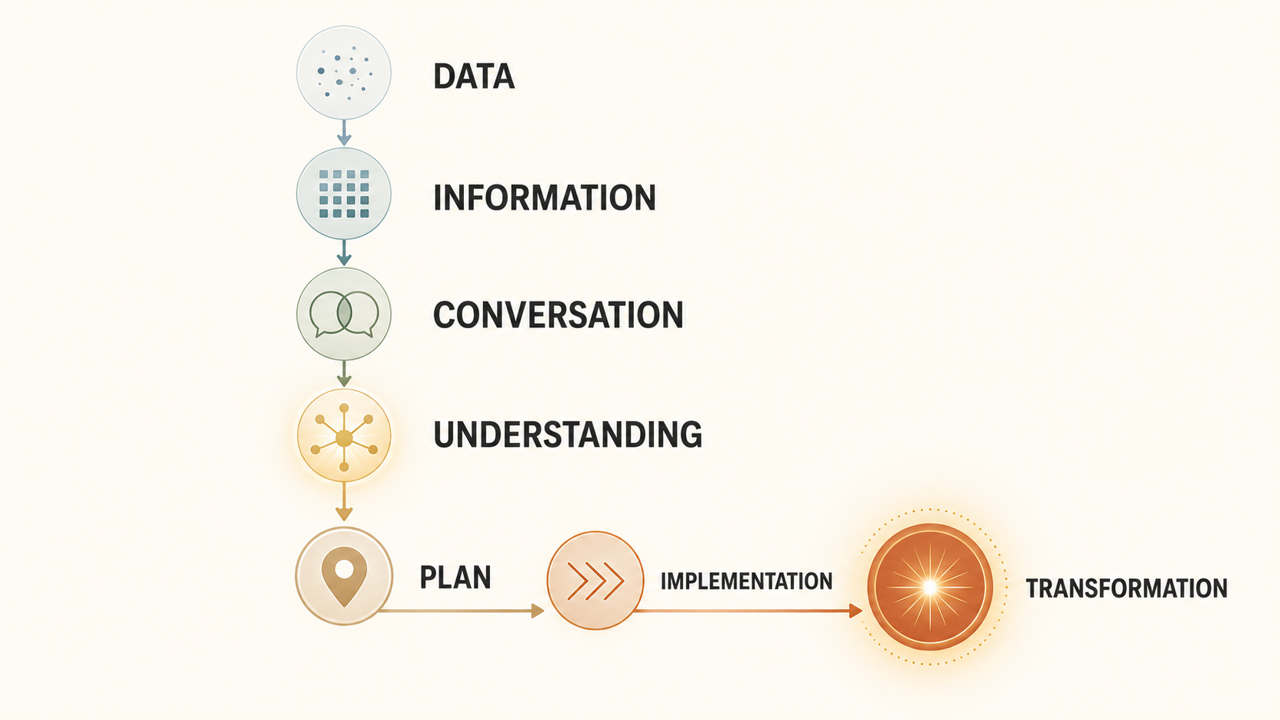
Data Creates Questions
Notes:
Data starts the conversation. It doesn't finish it.
Technology helps us collect and organize information.
Conversation helps us understand the person behind the information.
The goal is not more data; it is a plan the patient can successfully implement.

Slide 6
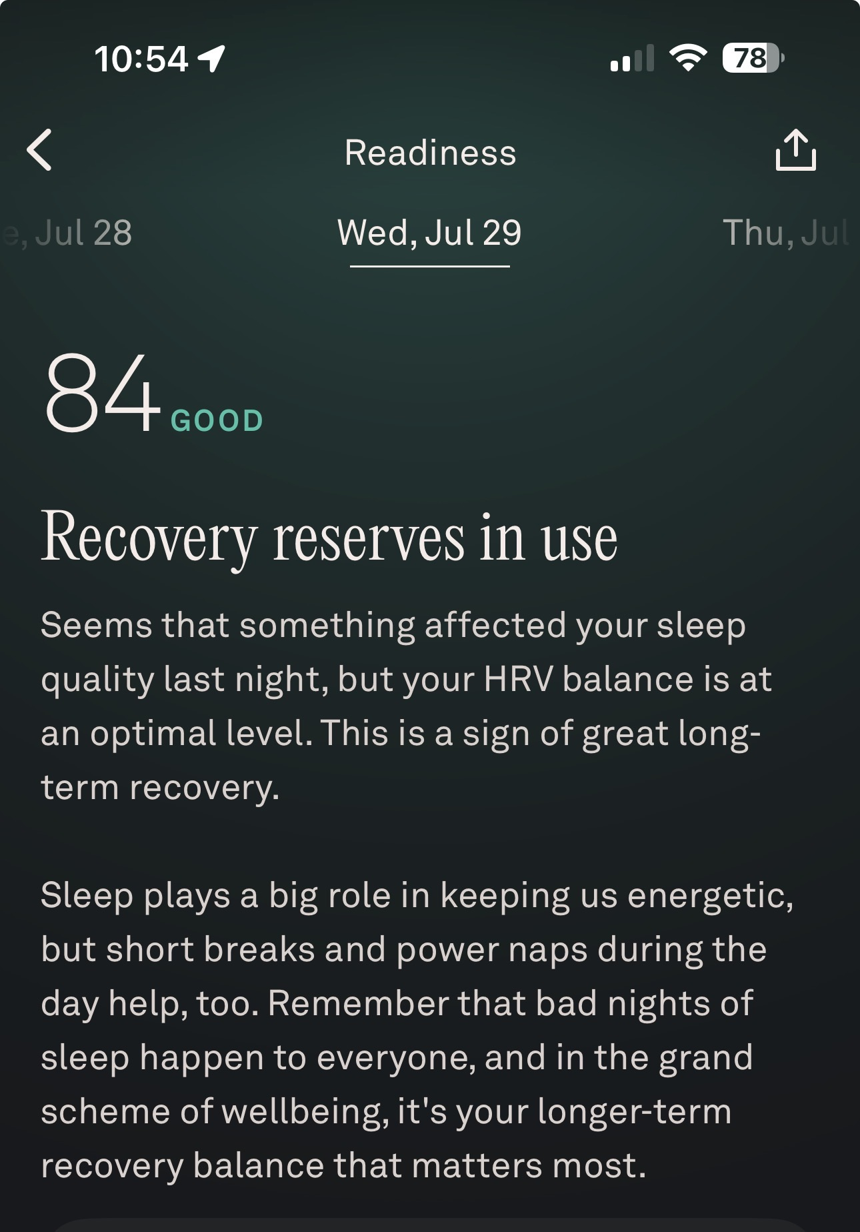
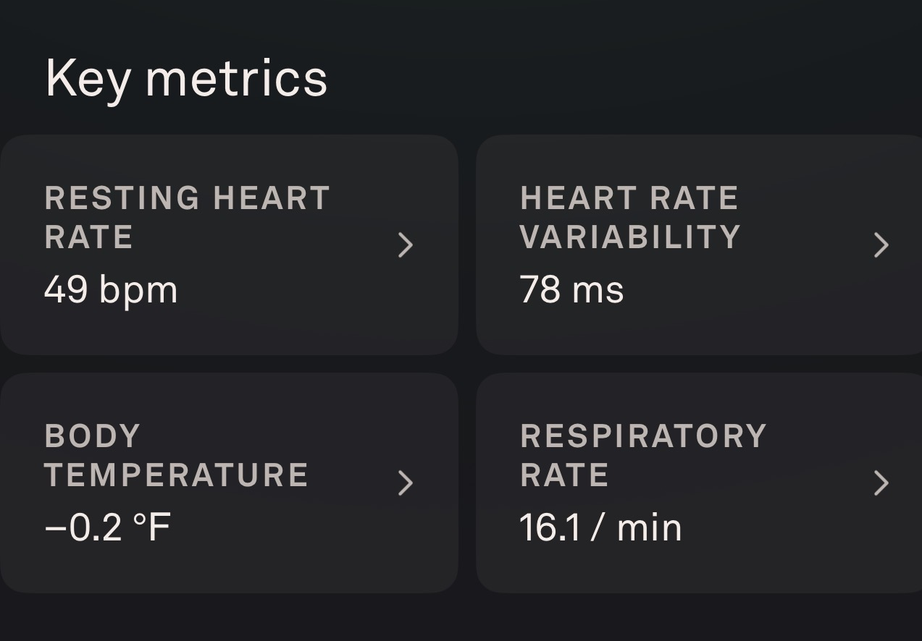
Oura
Notes:
My Oura wasn't wrong. It simply couldn't know my story.
The numbers accurately described poor sleep and recovery, but not why they were happening.
Two children under two, interrupted sleep, and newborn feedings completely change the interpretation.
Context changes interpretation.

Slide 7
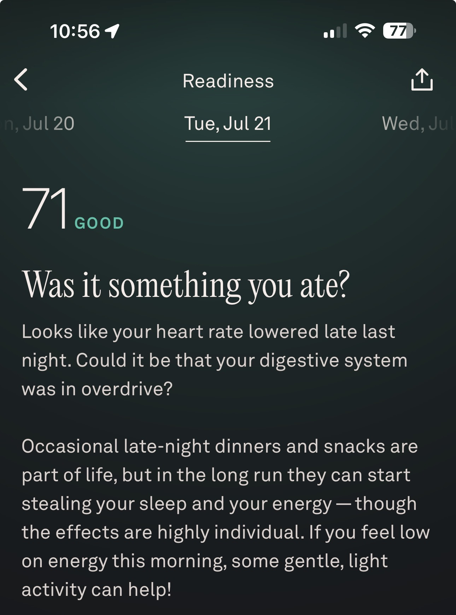
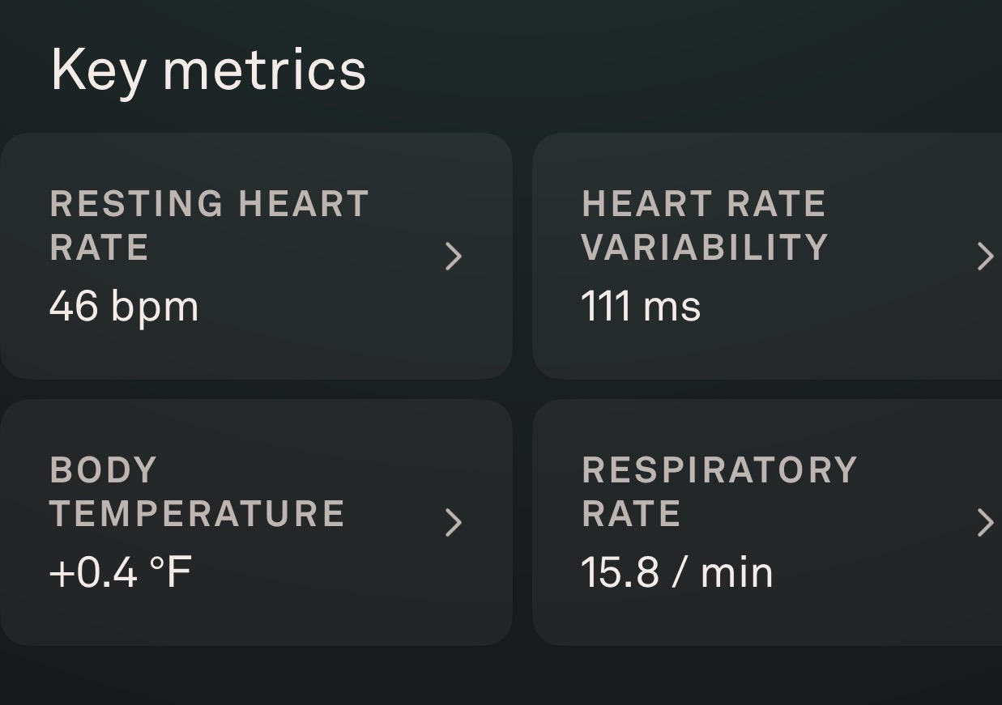
Oura
Notes:
My Oura wasn't wrong. It simply couldn't know my story.
The numbers accurately described poor sleep and recovery, but not why they were happening.
Two children under two, interrupted sleep, and newborn feedings completely change the interpretation.
Context changes interpretation.

Slide 8
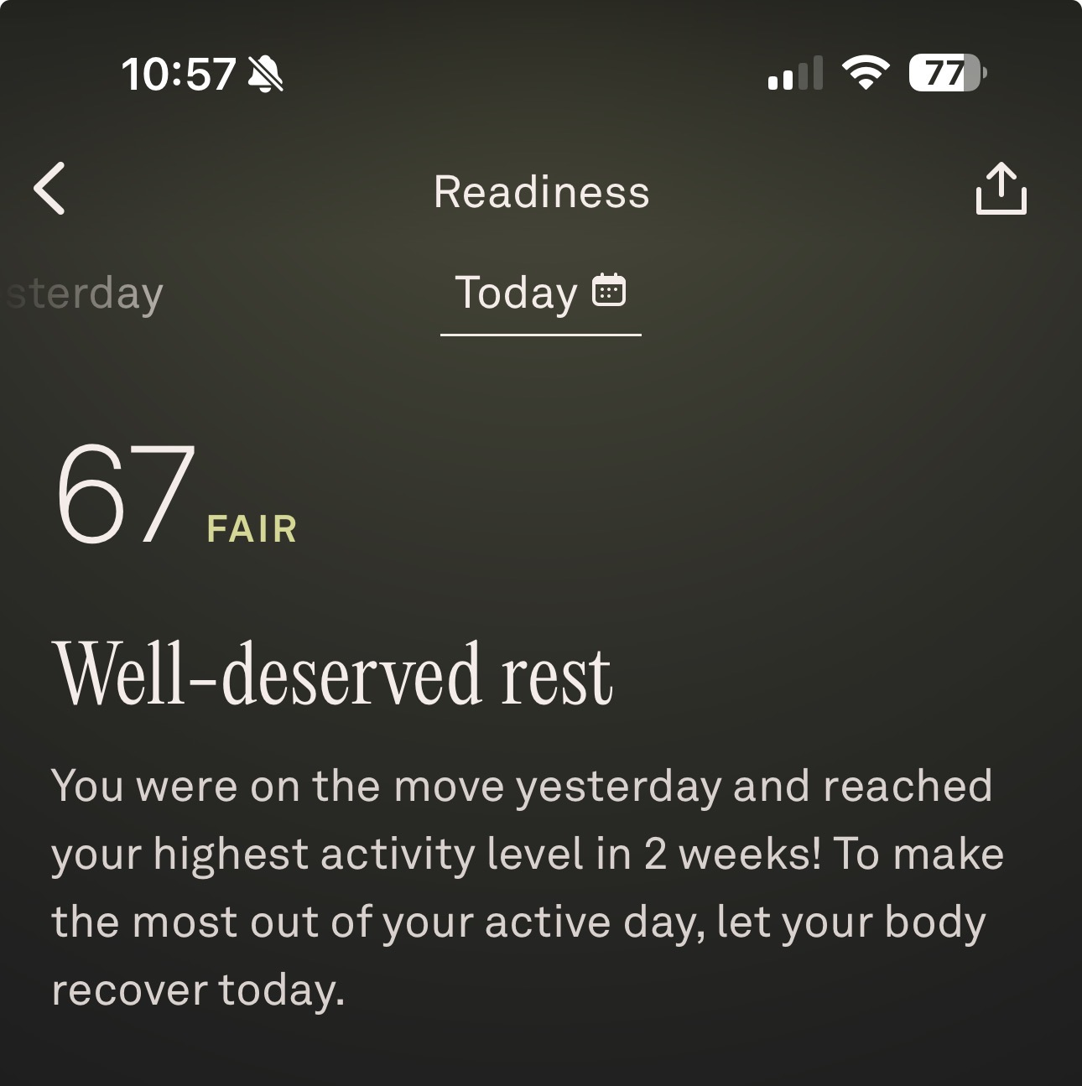
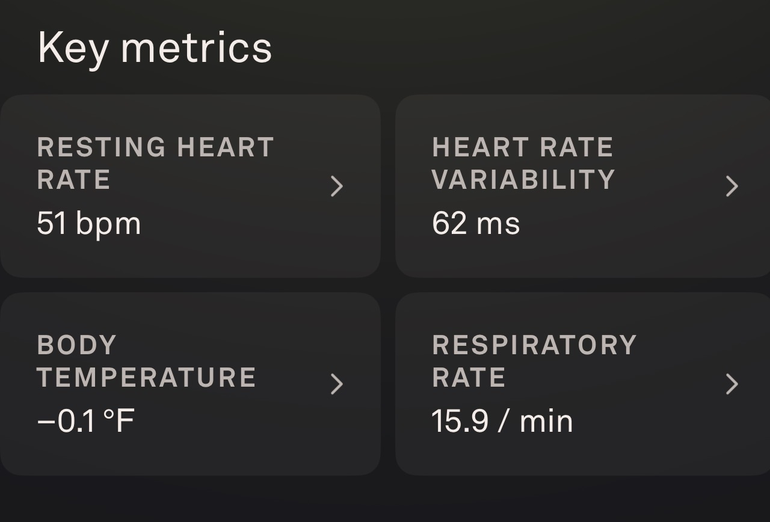
Oura
Notes:
My Oura wasn't wrong. It simply couldn't know my story.
The numbers accurately described poor sleep and recovery, but not why they were happening.
Two children under two, interrupted sleep, and newborn feedings completely change the interpretation.
Context changes interpretation.

Slide 9
Was Oura Wrong?
Oura showed:
Poor sleep • Poor recovery • Low HRV
What would you recommend?
WHAT OURA DIDN'T KNOW
Two children under two • Interrupted sleep • Newborn feedings
Stress wasn't pathology • Recovery wasn't ‘broken’
DATA WITHOUT CONTEXT IS INCOMPLETE.
Notes:
My Oura wasn't wrong. It simply couldn't know my story.
The numbers accurately described poor sleep and recovery, but not why they were happening.
Two children under two, interrupted sleep, and newborn feedings completely change the interpretation.
Context changes interpretation.

Slide 10
Was Oura Wrong?
Never make a recommendation until you understand why the data changed
Poor HRV after illness ≠ Poor HRV after a newborn
Elevated glucose after vacation ≠ Elevated glucose from insulin resistance
Fatigue after sickness ≠ Fatigue after blood loss
Notes:
Clinical Pearl
Data tells you what happened.
Conversation helps you understand why.

Slide 11
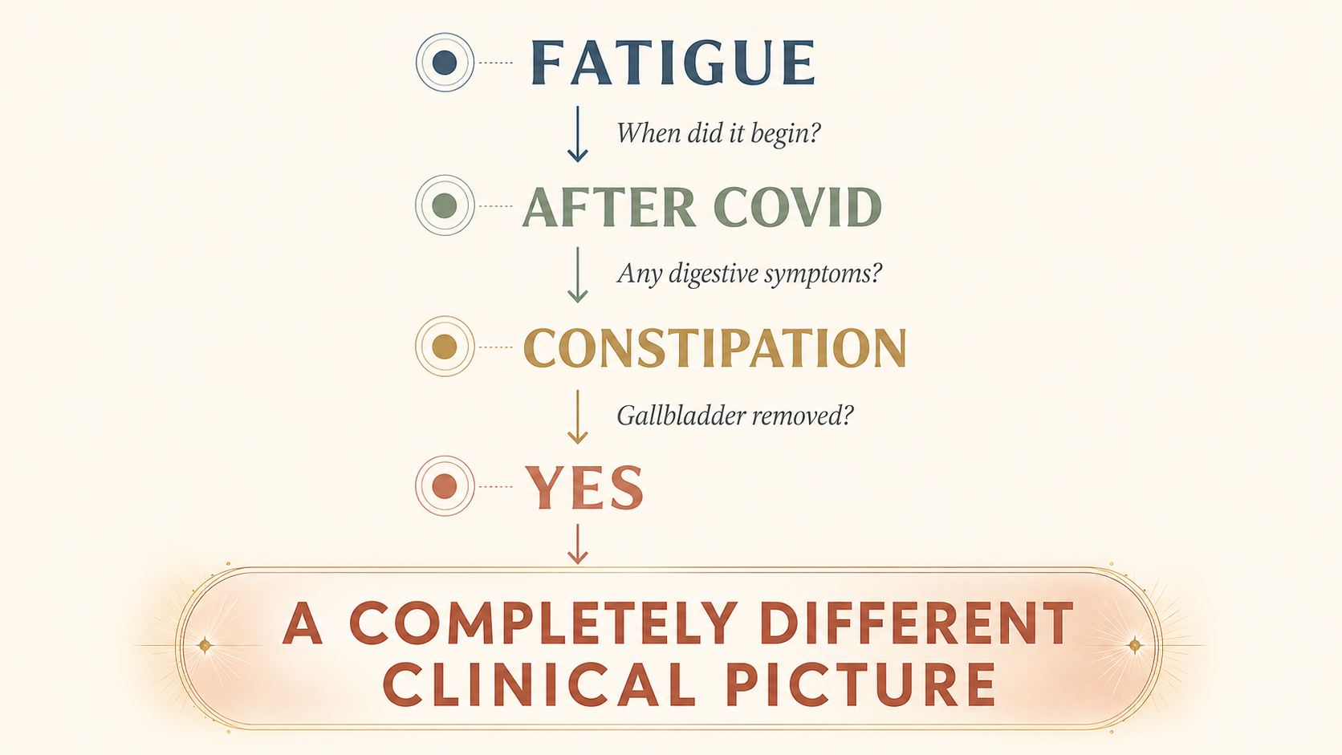
Every Answer Changes the Next Question
Notes:
We don't ask questions just to collect data.
Every answer changes what we ask next and how we interpret what came before it.
A symptom that sounds simple at first can lead to a completely different clinical picture.
This is why comprehensive intake matters.

Slide 12
Why We Spend So Much Time on Intake
A complete intake helps us understand:
• Timeline
• Patterns
• Priorities
• Obstacles
• Readiness
• The patient's story
THE BETTER THE INTAKE, THE BETTER THE OUTCOME.
Notes:
Intake isn't administrative. It is one of the most important clinical tools we have.
It helps us understand the full story before we decide where to intervene.
It determines not just what to do, but when to do it.

Slide 13
Data Creates Questions
Notes:
Data starts the conversation. It doesn't finish it.
Technology helps us collect and organize information.
Conversation helps us understand the person behind the information.
The goal is not more data; it is a plan the patient can successfully implement.

Slide 14
Why We Spend So Much Time on Intake
A complete intake helps us understand:
• Timeline
• Patterns
• Priorities
• Obstacles
• Readiness
• The patient's story
THE BETTER THE INTAKE, THE BETTER THE OUTCOME.
Notes:
Intake isn't administrative. It is one of the most important clinical tools we have.
It helps us understand the full story before we decide where to intervene.
It determines not just what to do, but when to do it.

Slide 15
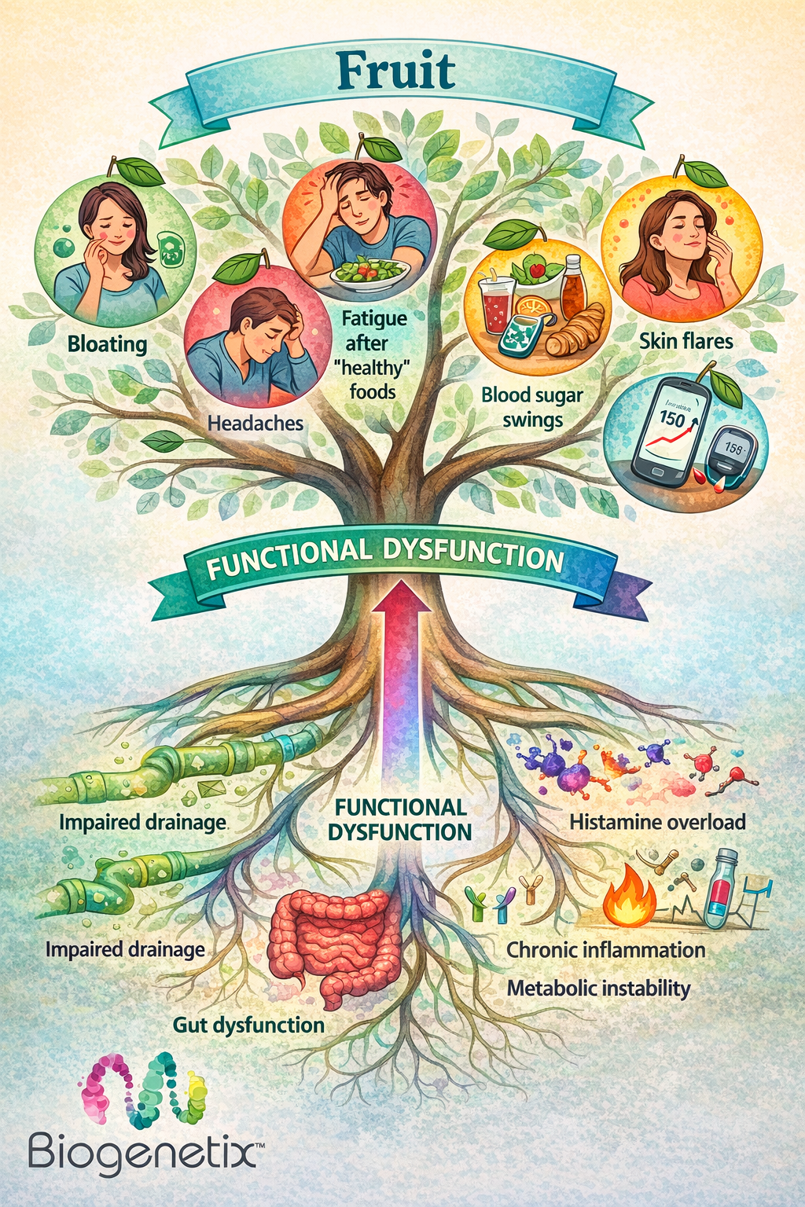
Symptoms are clues—not conclusions.
Fatigue • Brain fog • Bloating • Headaches • Poor sleep • Weight changes
I don't hear ‘fatigue’ and immediately think B12. I hear an invitation to ask more questions.
Symptoms start the investigation—they don't complete it.
Notes:
Symptoms tell us where to begin, not where to end.
I don't hear fatigue and immediately think B12. I hear an invitation to ask more questions.
Symptoms start the investigation—they don't complete it.

Slide 16
Patient B
Fatigue
↓
Heavy menstrual bleeding
↓
Iron deficiency
Patient A
Fatigue
↓
Poor sleep
↓
Newborn
Patient C
Fatigue
↓
Constipation
↓
Gut dysfunction
Notes:
Don't treat symptoms.
Understand the story behind the symptoms.

Slide 17
The Order Matters
Just because something is helpful...doesn't mean it's helpful FIRST.
• Detox
• Gut repair
• Blood sugar
• Hormones
• Exercise
• Fasting
THE RIGHT INTERVENTION AT THE WRONG TIME CAN STILL FAIL.
Notes:
Great clinicians don't just know what works. They know what matters most today.
Sequencing often determines whether a patient succeeds or becomes overwhelmed.
The right intervention at the wrong time can still fail.

Slide 18
Why We Don't Teach Everything at Once
INFORMATION DUMP
20 lab markers • 15 supplements • 10 diet changes
Multiple lifestyle goals
↓
OVERWHELM
LAYERED LEARNING
Today's focus: Sleep • Blood sugar • Two supplements
↓
CONFIDENCE
PEOPLE IMPLEMENT WHAT THEY UNDERSTAND.
Notes:
This was one of the biggest lessons from seeing patients one-on-one.
We intentionally didn't explain every lab marker during the first visit.
We built understanding layer by layer so the patient knew what mattered now.
Patients don't need to know everything today. They need to know the next right step.
Clinical Pearl
Great education isn't about saying more.
It's about helping patients remember and apply what matters most.

Slide 19
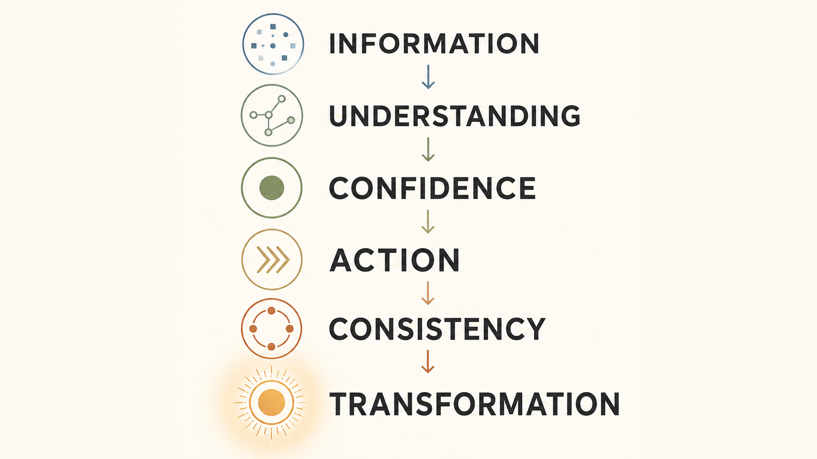
Information Doesn't Create Transformation
Notes:
Looking back, I believe this was one of the biggest reasons my patient retention was so high.
Patients didn't leave overwhelmed. They left knowing exactly what to do next.
Understanding creates confidence, and confidence improves implementation.
Talking Points
* This was one of the biggest lessons from seeing patients one-on-one.
* Patients didn't leave overwhelmed.
* They left knowing exactly what to do next.
* That built confidence.
* Confidence improved implementation.
Clinical Pearl
Understanding creates confidence.
Confidence creates consistency.

Slide 20
Great Protocols Can Still Fail
PATIENT A
Understands the plan • Knows why • Follows through
↓
IMPROVES
PATIENT B
Overwhelmed • Inconsistent • Unsure why
↓
MINIMAL PROGRESS
IMPLEMENTATION MATTERS AS MUCH AS INFORMATION.
Notes:
Sometimes we say a protocol didn't work.
More often, the protocol wasn't fully implemented—or the patient never understood how to implement it.
Helping patients implement change is part of our job, not an optional extra.
Clinical Pearl
Implementation matters as much as information. If not more!

Slide 21
Five Questions to Ask
What is the patient trying to accomplish?
Why is this happening now?
What matters most today?
What will this patient actually implement?
What can wait until the next visit?
Notes:
* This framework has shaped nearly every consultation I've done.
* Every recommendation passes through these questions.
Clinical Pearl
Just because you can teach something today...
doesn't mean you should.

Slide 22
The New Role of the Practitioner
TECHNOLOGY CAN
Collect data • Organize information • Summarize research
GREAT CLINICIANS PROVIDE
Context • Communication • Prioritization
Sequencing • Coaching • Clinical judgment
TECHNOLOGY INFORMS. CLINICIANS TRANSFORM.
Notes:
AI isn't replacing great clinicians. It is raising the value of great clinical thinking.
Patients need someone who can make sense of the information in the context of their life and physiology.
Technology informs. Clinicians transform.

Slide 23
The Clinical Consulting Team
Why our process works:
• Comprehensive intake
• Thoughtful interpretation
• Personalized sequencing
• Layered education
• Ongoing accountability
OUR GOAL ISN'T TO GIVE PATIENTS MORE INFORMATION.
IT'S TO HELP THEM SUCCEED.
Notes:
We don't have secret protocols. We have a structured process.
We combine comprehensive intake, thoughtful interpretation, personalized sequencing, layered education, and accountability.
We focus on the next right step rather than every possible step.
Clinical Pearl
Structure creates confidence.
Confidence improves outcomes.

Slide 24
Beyond the Data - Final Thoughts
Patients don't need:
More information
More supplements
More protocols
Patients need:
Clarity
Understanding
Priorities
A plan they can implement
Someone to guide them

Slide 25
Technology helps us collect information.
Conversation helps us discover the story.
Clinical judgment helps us decide what to do next.
Patients don't need to know everything today.
They need to know the next right step.
Notes:
The future of healthcare isn't about who has the most information.
It is about who can best listen, understand, prioritize, communicate, and guide.
Patients rarely need more information. They need clarity, a plan they understand, and someone who can connect the dots.
That is where meaningful transformation begins.
Closing Story
"Looking back, I don't think my patient retention was unusually high because I knew more than other practitioners."
"I think it was because my patients left every visit knowing exactly what to do next."
"And that's really what this presentation has been about."
"The goal isn't to transfer information."
"The goal is to create understanding that leads to action."

Slide 26
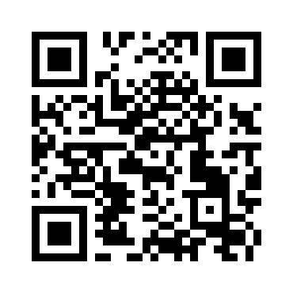
We Want to Hear from You!
Give us your Casual Friday feedback
with this short 5-question survey.
biogenetix.com/survey

